Slide 1
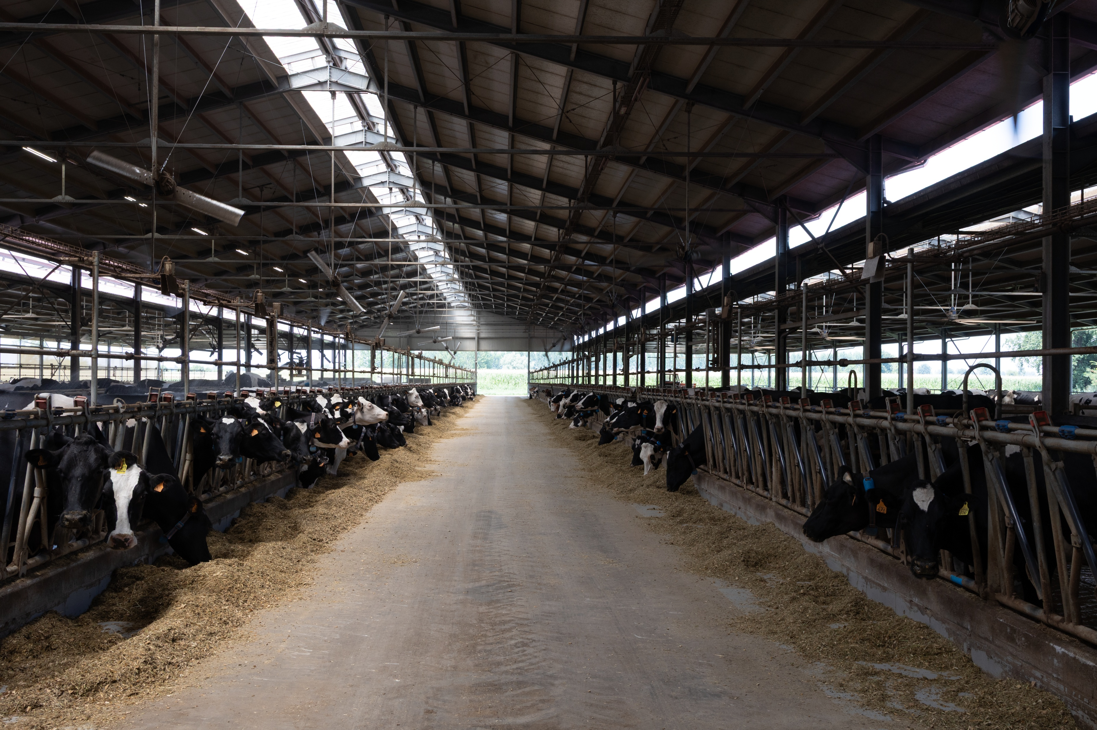
THE VALUE OF
CAP PILLAR II
Scaling innovation and sustainability
for the next generation of farmers
Foto aerea stalla
The Case of Cascina Bosco
Pietro Baldrighi • Dairy Farmer

Slide 2
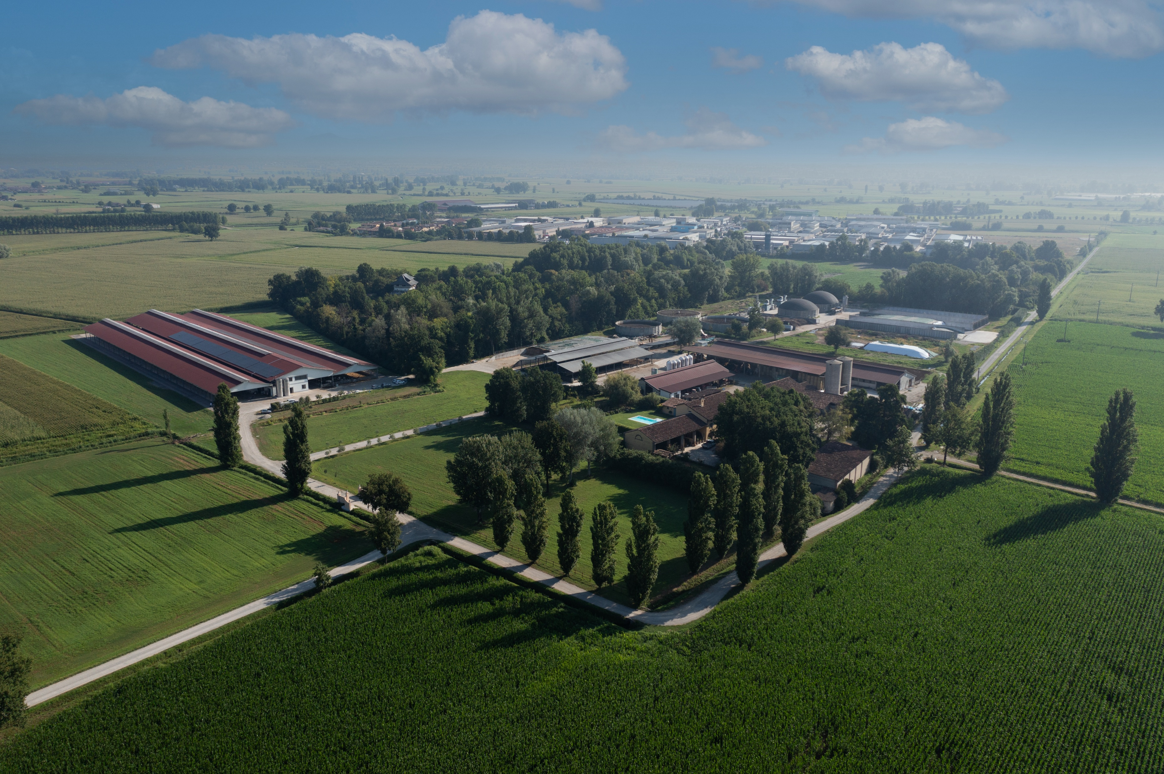
Cascina Bosco
02
A family dairy farm near Crema, in the heart of Northern Italy’s dairy region
260 ha
≈1,000
450
farmland supporting the herd
cattle on the farm
lactating cows
Our milk is delivered to a dairy cooperative and used for Grana Padano PDO production
The farm integrates milk production, crop cultivation, biogas and solar energy
CASCINA BOSCO • STRASBOURG

Slide 3
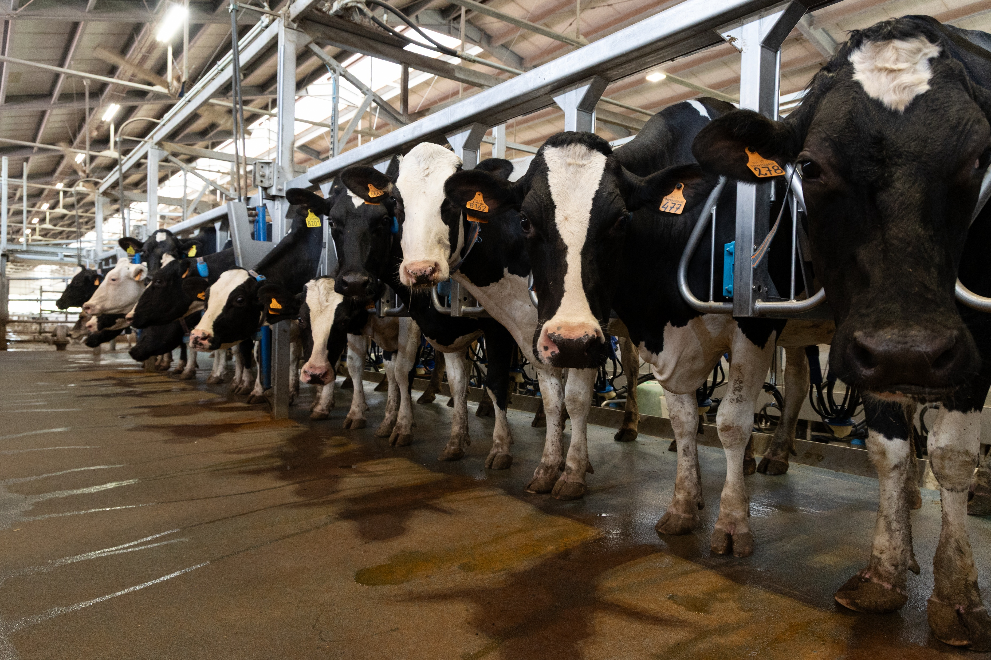
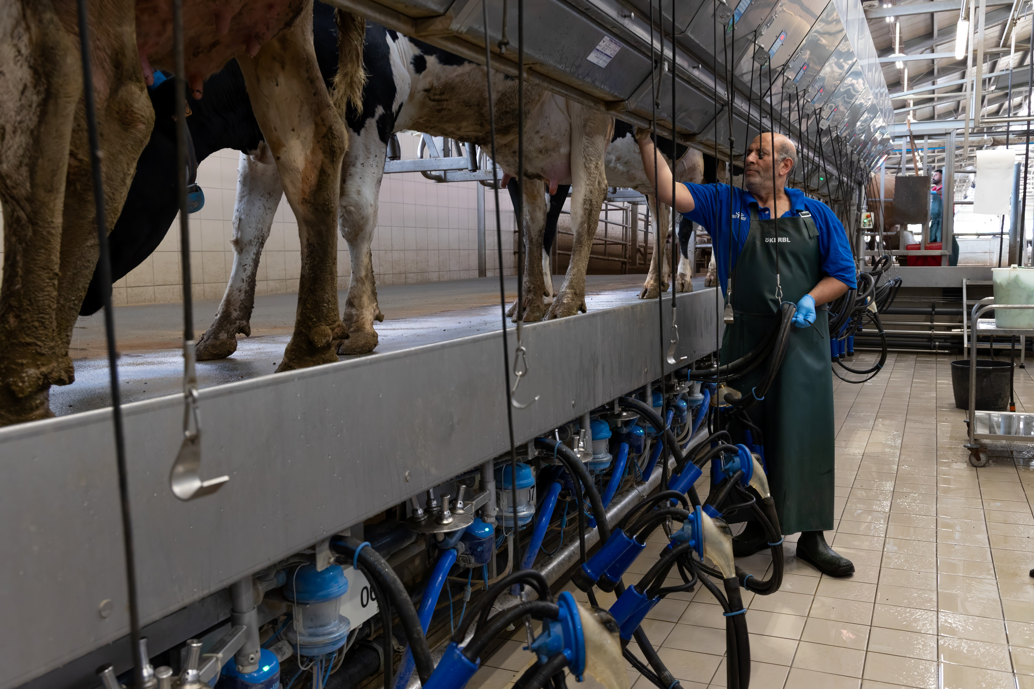
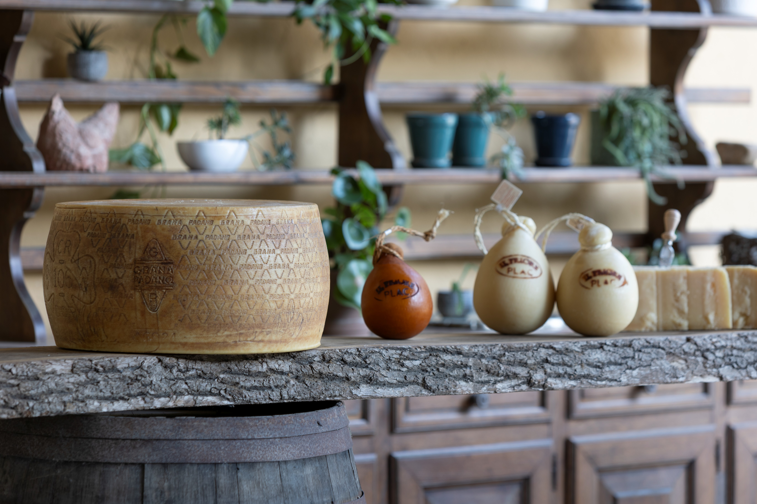
Why we decided to invest
03
A young farmer can take responsibility only when the farm offers a credible future
COWS
PEOPLE
BUSINESS
More space, better cooling and closer health monitoring → higher animal welfare
A safer, more comfortable and pleasant workplace
The productivity needed to remain competitive over time
The investment was a commitment to continue farming, not simply an expansion project
CASCINA BOSCO • STRASBOURG

Slide 4
The RDP investment project
04
2021–2022
RDP support helped mobilise an investment far larger than the public contribution
PROJECT SCOPE
€1.03m
New dairy barn and 18+18 parallel milking parlour
≈ €4.5m total investment
RDP support
Public support represented about 23% of the total investment
Minimum tillage equipment
Weather station and field sensors
Eligible expenditure was capped at €3.5m. The farm invested beyond that ceiling
CASCINA BOSCO • STRASBOURG

Slide 5
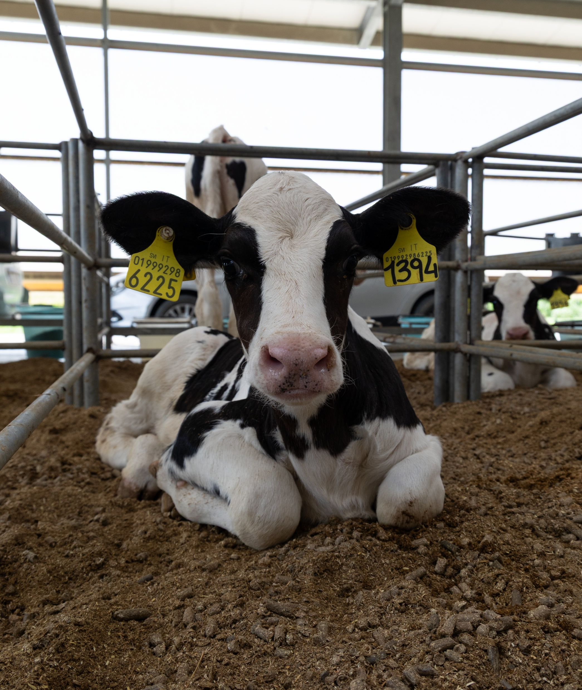
A barn designed around cows and people
05
COMFORT AND COOLING
MILKING AND HANDLING
More space for lactating cows
18+18 parallel milking parlour
Fans increase speed with temperature and humidity change. Presence sensors activate sprinklers only when cows are at the feed bunk
A sorting gate directs cows to a multipurpose pen for treatment, regrouping or drying off
STAFF COMFORT AND SAFETY
WATER REUSE
Better working conditions for our 13 employees
Warm water recovered
Wider spaces, safer animal handling and a layout designed to reduce physical strain and operational risks
Heat recovered during milk cooling provides warm drinking water and supplies other barn uses
CASCINA BOSCO • STRASBOURG

Slide 6
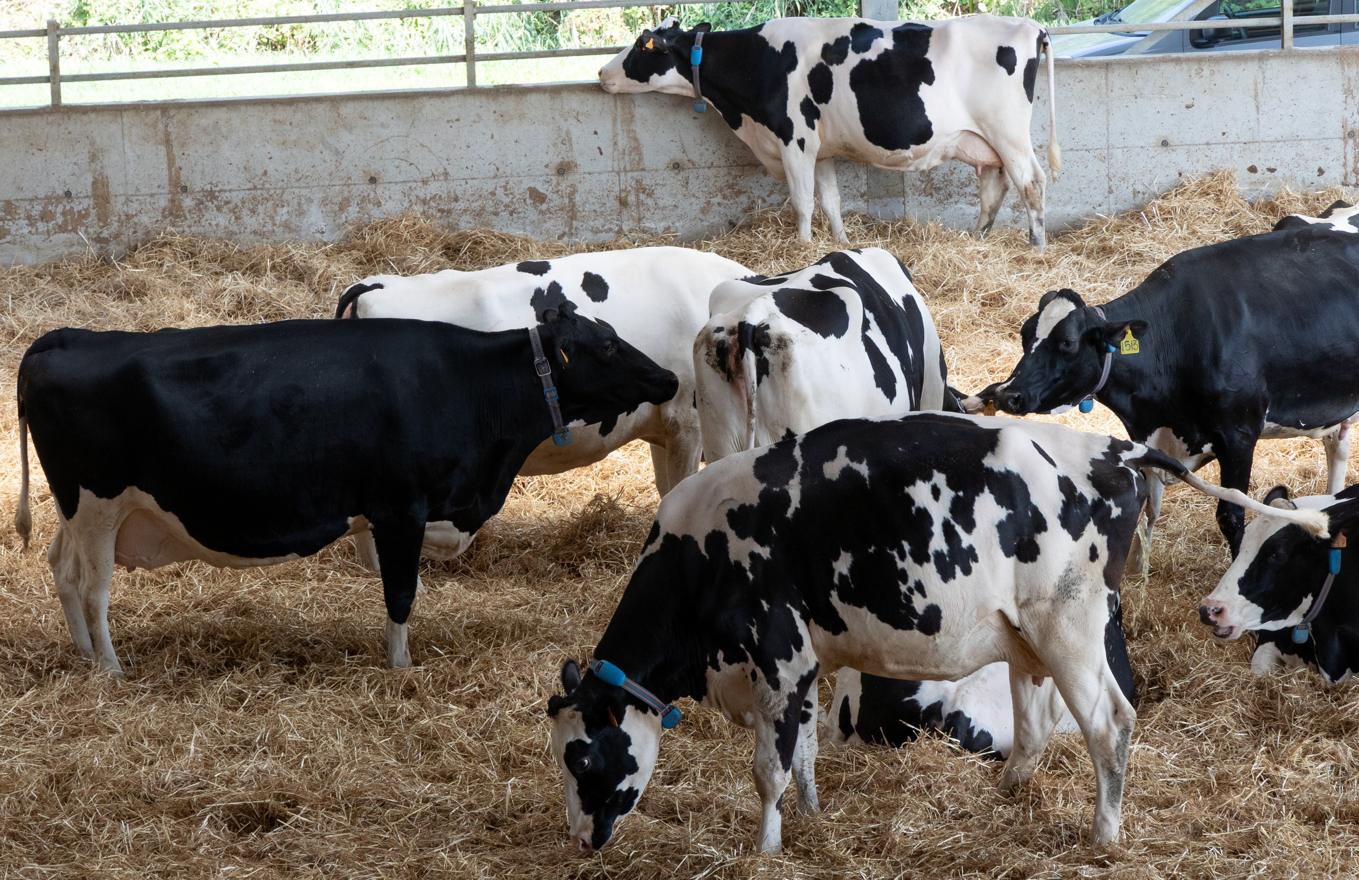
Continuous data supports daily decisions
06
Milk data at every milking
Cow data throughout the day
Yield, fat, protein, lactose, conductivity and blood detection
Collars and antennas continuously monitor rumination, feed intake and activity linked to health and heat detection
Data allows the team to identify animals in need of care earlier and focus attention where it is needed
The infrastructure also allowed further innovation after the RDP project, including AI monitoring systems and an automated feed-pushing robot
CASCINA BOSCO • STRASBOURG

Slide 7
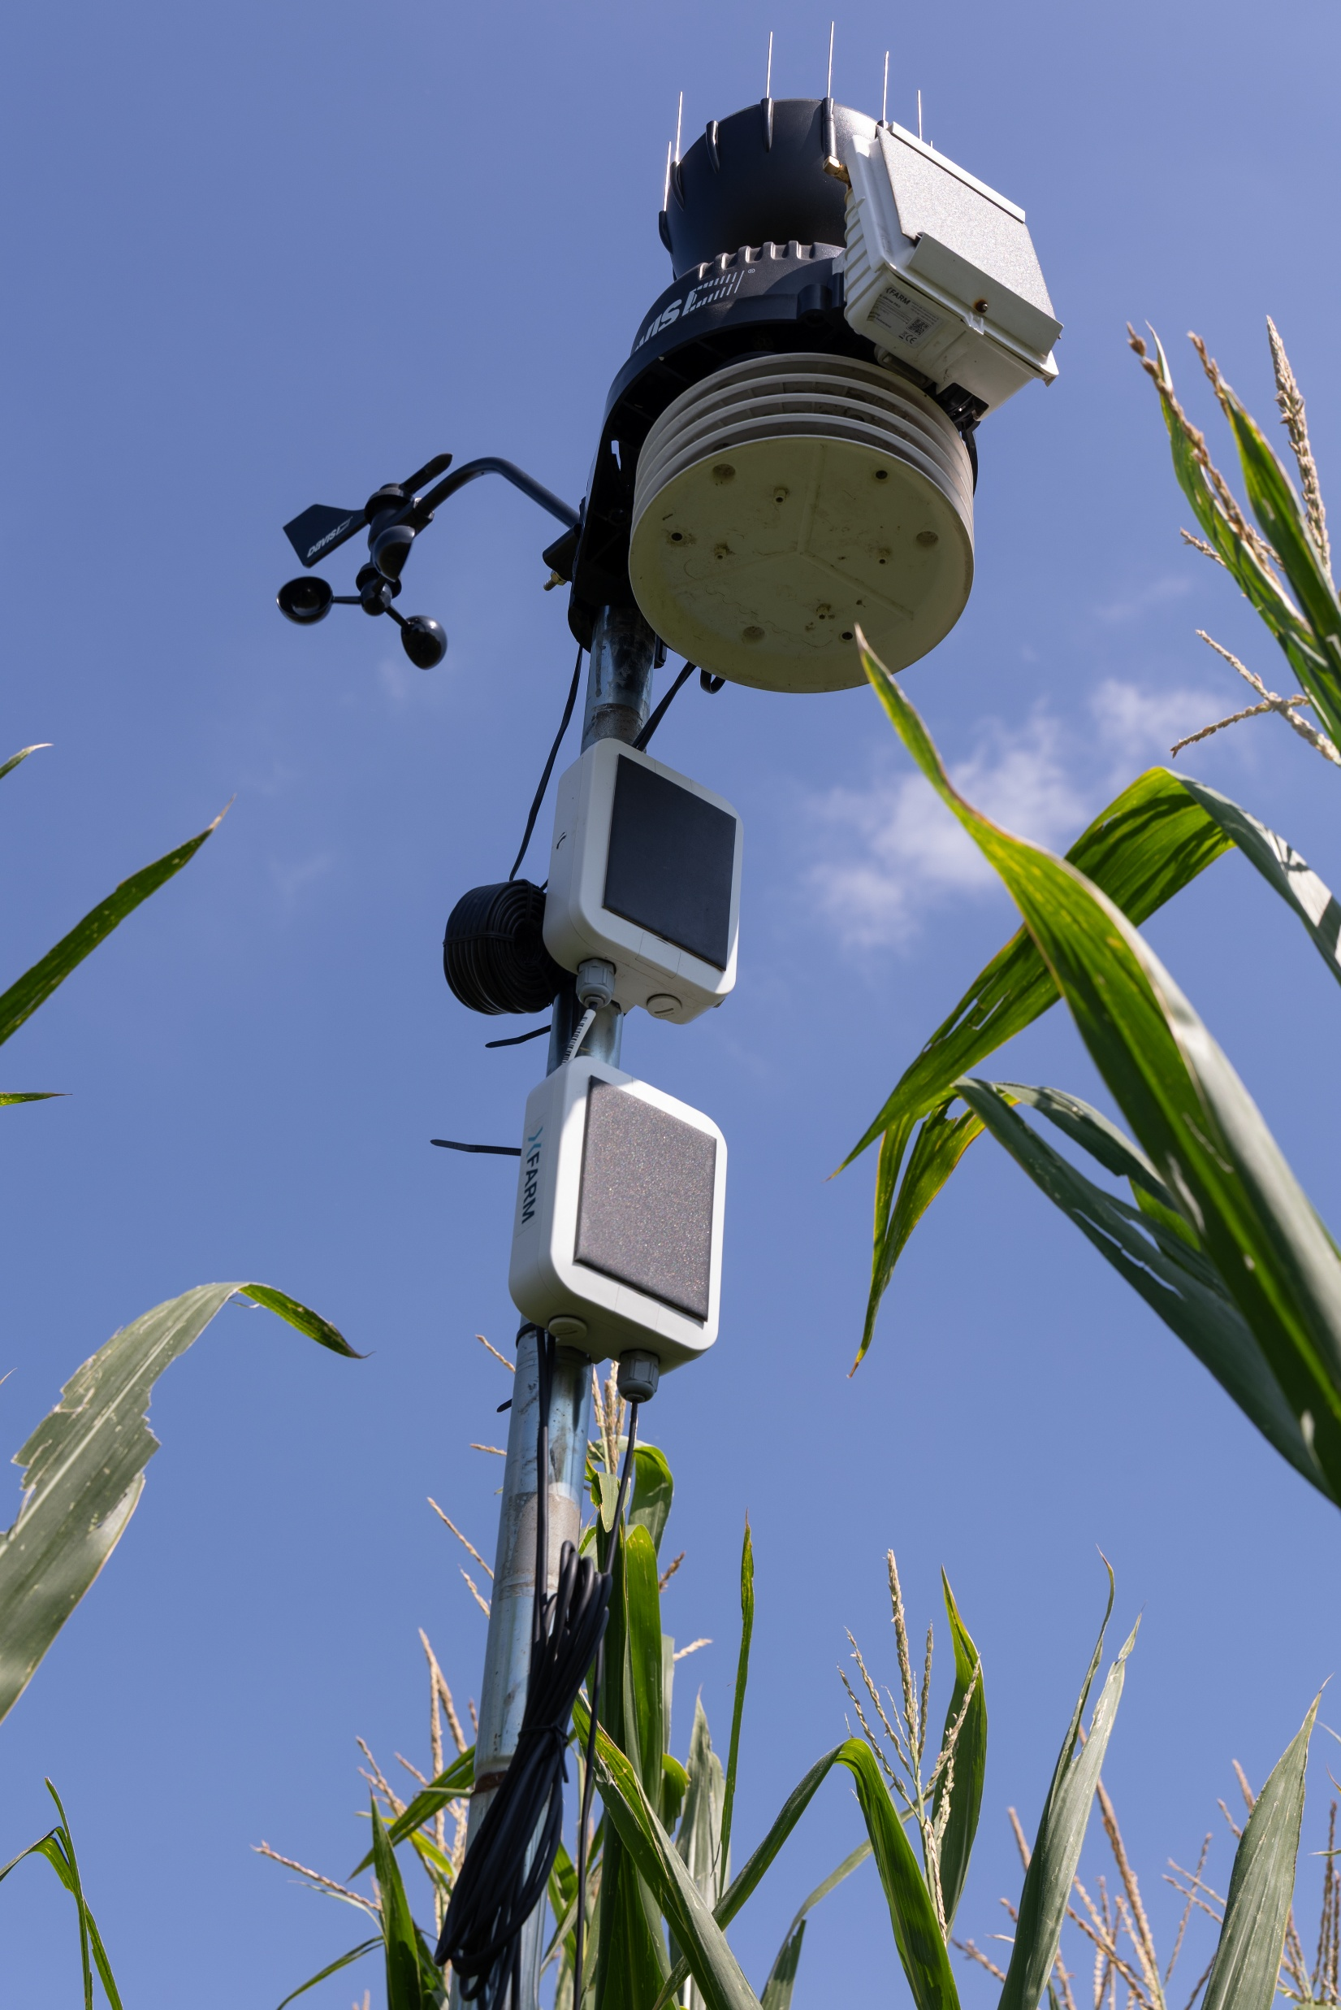
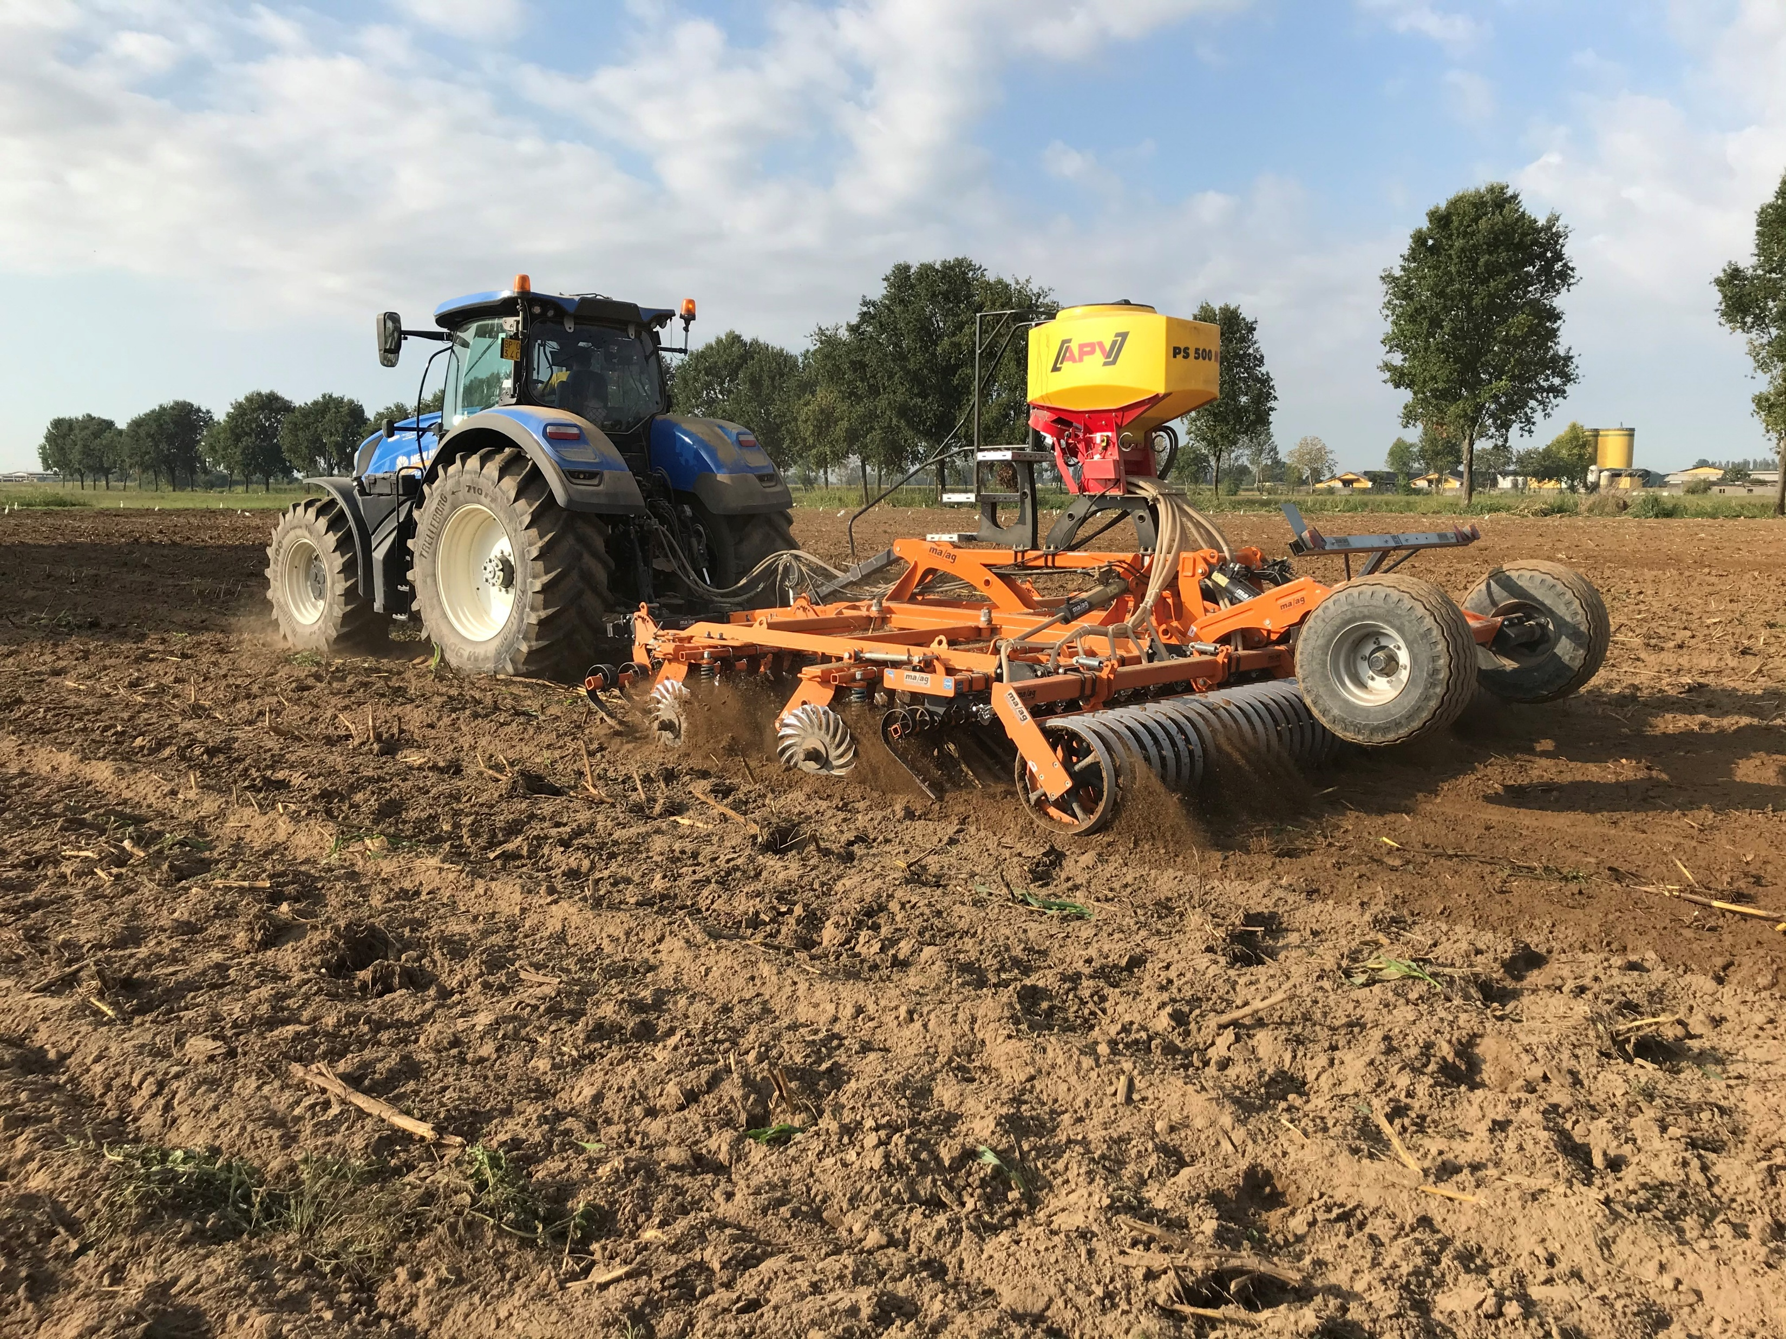
Innovation beyond the barn
07
Vertical tillage
Field monitoring
Minimum soil disturbance supports more efficient field operations and a gradual move towards reduced tillage
Field data improves the timing of irrigation, crop protection and other operations
CASCINA BOSCO • STRASBOURG

Slide 8
Rural Development Programme: a policy worth preserving
08
RDP support covered approximately 23% of our investment
It helped our family commit approximately €4.5 million to the future of the farm
Dedicated agricultural investment support reduces risk, mobilises private capital and fosters generational renewal by giving young farmers the confidence to take responsibility
Future European farmers deserve the same opportunity, but the reality is that the Commission’s proposal for the future CAP reduces its budget by 22%
How will it be possible to attract new farmers under these conditions?
THANK YOU

