Slide 1
Can the new CAP support a more sustainable livestock system?
Prof Thia Hennessy, University College Cork, Ireland

Slide 2
Challenges facing livestock
Continued low profitability and incomes
Exposure to extreme weather, input and output price volatility
Need to reduce environmental impact
Need to maintain high levels of animal welfare
Generational Renewal

Slide 3
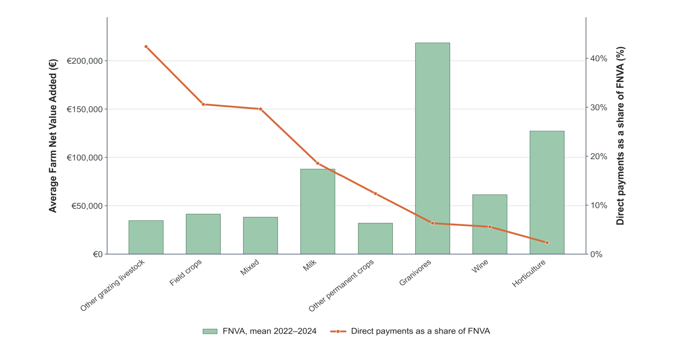
Why the CAP is important
Source: Authors’ Own Calculations based on FSDN data

Slide 4
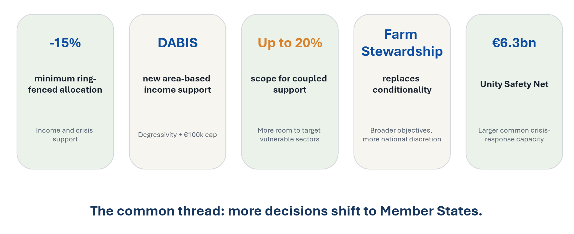
What changes under the proposed CAP?​

Slide 5
Implications for Livestock Systems
Overall funding may decline depending on MS preferences
  Less Common CAP
Tighter ring-fenced envelope intensifies the trade-off between basic income support, environmental incentives, investment and resilience.
Flat-rate payments & degressivity may benefit livestock farms
  Typically lower payments
  Depends on redistribution principles

Slide 6
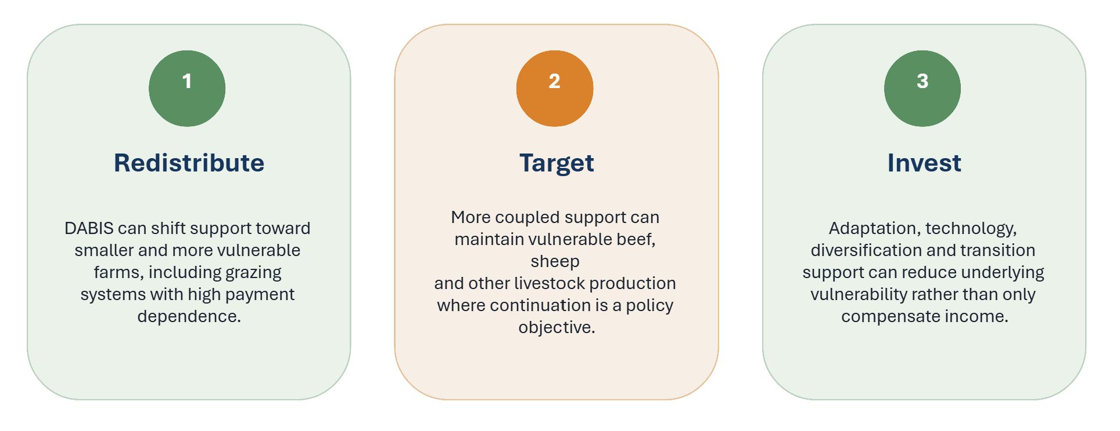
Where the new CAP could help livestock​

Slide 7
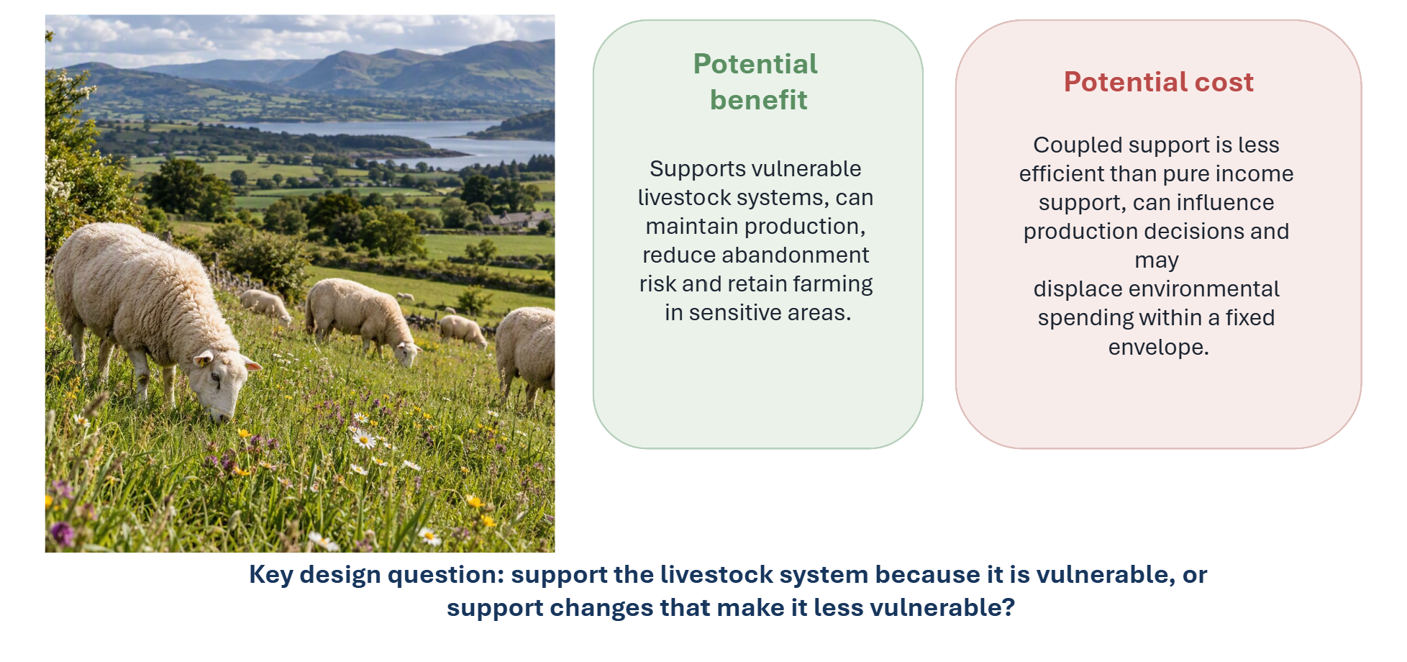
Is more coupled support the best option?

Slide 8
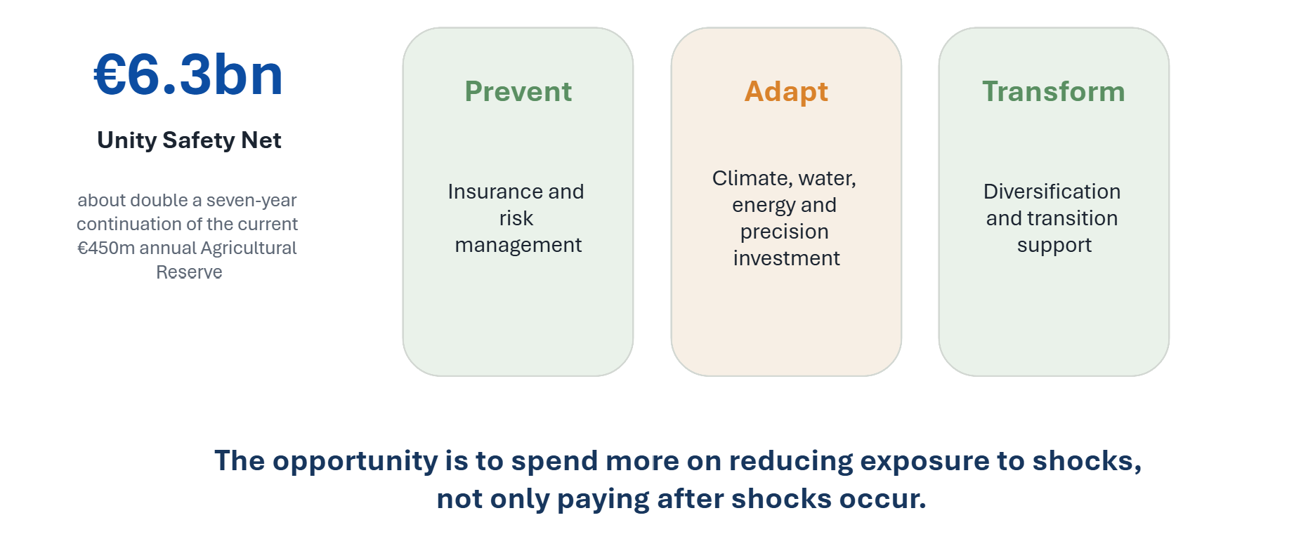
A more resilient livestock system?

Slide 9
Can the new CAP support a more sustainable livestock system?
YES, BUT……
More fragmented – will depend on MS ambition
Can be more targeted – how best to measure vulnerability
Needs targeted investment in environmental measures
Invest in resilience building – proactive not reactive

Slide 10
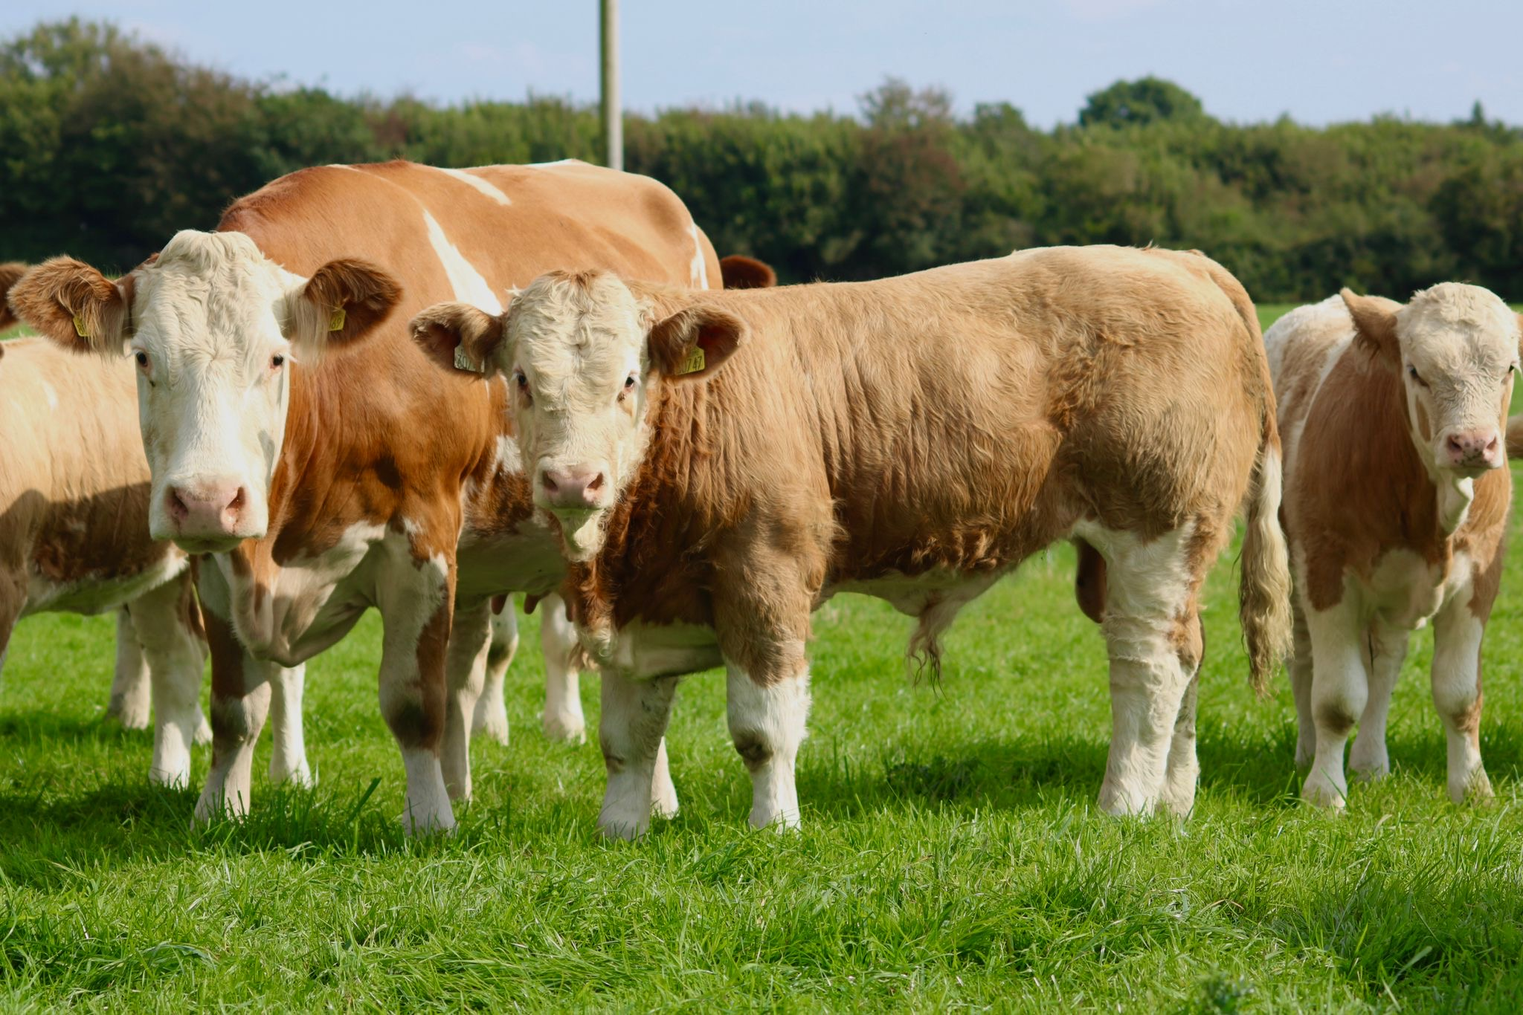
Questions?...

