Slide 1
Presentation of the Hauts-de-France Region's manifesto on the CAP 2028-2034
based on an assessment of the current situation and a forward-looking analysis conducted in collaboration with the Regional Chamber of Agriculture

Slide 2
HAUTS-DE-FRANCE: AN AGRICULTURAL POWERHOUSE, INCLUDING LIVESTOCK FARMING
The Hauts-de-France region ranks first in France for several major crop productions.
But mixed farming systems are an economic and agronomic strength for our region.
  41,000 people employed in agriculture
  18,882 farms participating in the CAP
  9% of national agricultural value added
  A sector dominated by family-run and professional farms
  Structured livestock sectors integrated into a robust agri-food network
Livestock farming makes it possible to make use of byproducts from crop production, diversify income streams, and create value within the farms themselves.
The Hauts-de-France region is not only a major agricultural region; it also represents a strategic food production capacity for Europe.

Slide 3
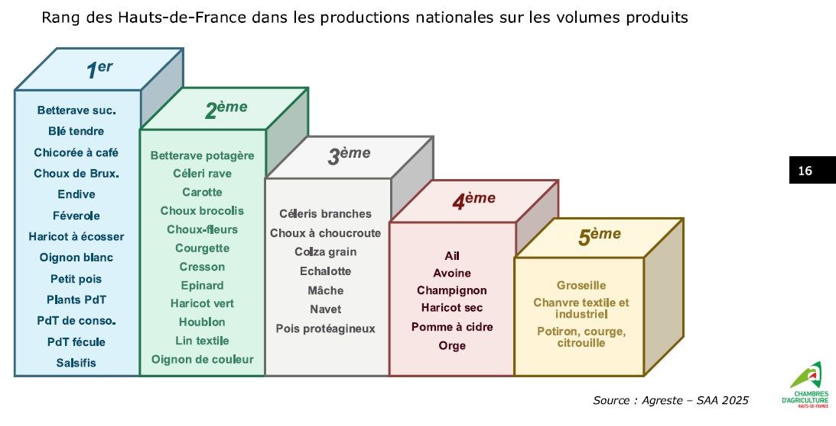
Hauts-de-France's ranking in national production by volume
1st
Sugar beet
Soft wheat
Coffee chicory Brussels sprouts
Endive
Field beans
String beans
White onion
Green peas
Potato seedlings Table potatoes
Starch potatoes
Salsify
2nd
Beet
Celeriac
Carrot
Broccoli
Cauliflower
Zucchini
Watercress spinach
Green beans
Hops
Fiber flax
Colored onions
3rd
Branch cabbage
Sauerkraut cabbage
Grain rapeseed
Shallot
Lamb's lettuce
Turnip
Protein peas
4th
Garlic
Oats
Mushrooms
Dried beans
Cider apples
Barley
5th
Red currant
Textile and industrial hemp
Pumpkin and squash

Slide 4
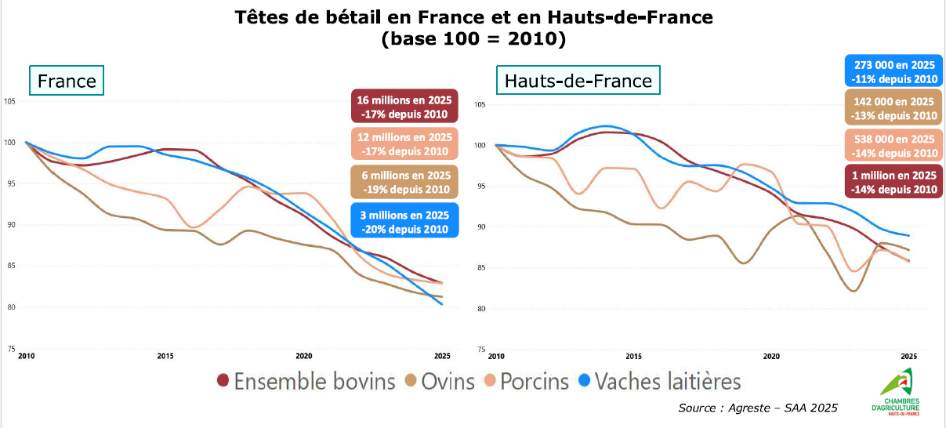
A model that has been weakened today
How can we expect European agriculture to strengthen its food sovereignty while allowing part of its production capacity to gradually disappear?
The number of livestock farms has declined sharply in recent years.
Livestock in France and in the Hauts-de-France region
(base 100 = 2010)
273 000 in 2025
-11% since 2010
16 millions in 2025
-17% since 2010
142 000 in 2025
-13% since 2010
12 millions in 2025
-17% since 2010
538 000 in 2025
-14% since 2010
6 millions in 2025
-19% since 2010
1 million in 2025
-14% since 2010
3 millions in 2025
-20% since 2010
Cattle herd
Sheep
Pigs
Dairy cows
Without sufficient income, livestock farming cannot be sustained, nor can it be passed on to the next generation.

Slide 5
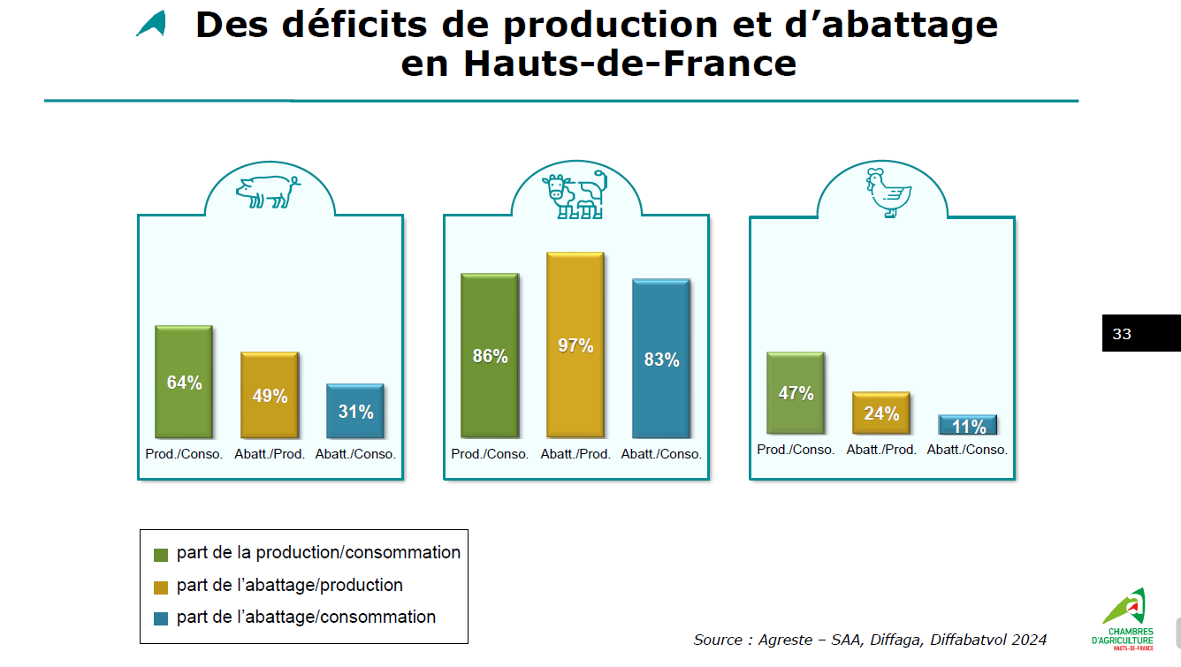
Shortfalls in Production and Slaughter in the Hauts-de-France Region
Slaughter./
Prod.
Slaughter./
Prod.
Slaughter./
Prod.
Slaughter./
Prod.
Slaughter./
Prod.
Slaughter./
Prod.
Part of production/consumption
Part of slaughter/production
Part of slaughter/consumption

Slide 6
A 35% decline in the number of farms specializing in livestock production over 10 years
Vegetables or mushrooms
Field crops
Viticulture
Fruit or other perennial crops
Dairy cattle
Beef cattle
Mixed cropping and/or mixed livestock farming
Swine and poultry
Flowers and/or miscellaneous horticulture
Sheep or goats
Dual-purpose cattle
Equines and/or other herbivores
In 2020, 4,900 farms specialized in livestock production
  Compared with 7,500 in 2010
Sources : Agreste, RGA 2010 et 2020, traitement CRA Hdf

Slide 7
OUR FARMING OPERATIONS ARE PRODUCTIVE… BUT NOT RECOGNIZED ENOUGH BY EXISTING TOOLS
The ICHN is based on a legitimate rationale: to compensate for natural and regional disadvantages. It is not our intention to call this tool into question.
However, another reality must be taken into account: that of productive agricultural regions where livestock farming is economically vulnerable despite strong production potential.
  Competition between arable land with adequate potential and forage land
  Land and societal pressures related to urbanization (gaps in development = grasslands & neighborhood acceptance)
  Difficulty in maintaining the livestock ecosystem (veterinarians, slaughterhouses, etc.) in areas specialized in crop production
  Livestock farming is essential for protein and nitrogen self-sufficiency
  Maintenance of a budget dedicated to LSU-based coupled payments, without stocking density criteria, to recognize the environmental benefits of using byproducts)
  Targeted support for “productive” grassland areas
  Increased investment support (adapting buildings to climate change, animal welfare, AND farmer well-being)
  Increased support for new entrants to the livestock sector
  Streamlining the administrative burdens on the livestock sector (cross-compliance)

Slide 8
PRIORITY 1—ESTABLISHING EUROPEAN SUPPORT FOR COMMERCIAL LIVESTOCK FARMING
A complementary tool to the ICHN
We propose providing greater support for productive livestock systems, in addition to measures designed for regions facing natural disadvantages.
This support could target farms that:
maintain a significant number of livestock units (LU)
contribute effectively to food production
are integrated into mixed crop-livestock systems
utilize byproducts from crop production
Our goal : To shift from an approach that primarily supports land area or compensates for natural disadvantages to one that also recognizes the economic and productive contribution of livestock farming.
The ICHN compensates for a disability. We offer a complementary tool to support production capacity.

Slide 9
PRIORITY 2 – MAKING INVESTMENT THE SECOND DRIVING FORCE OF THE CAP
Turning Public Support into Production Capacity
The future of livestock farming cannot rely solely on income support.
We are calling for a sufficiently ambitious European budget for investment in the second pillar.
Priorities: ADAPT - PRODUCE - INNOVATE - TRANSFER
Secure the farm → reassure lenders → invest → reduce costs → strengthen competitiveness → maintain production → facilitate transfer.
Investment is not an expense incurred to support the transition; it is an investment in the productive capacity of European agriculture.

Slide 10
EUROPE HAS A STAKE IN PRESERVING THE LAND THAT WILL BE ABLE TO PRODUCE IN THE FUTURE
The Hauts-de-France region has particularly significant strengths in the European context:
STRONG PRODUCTION CAPACITY
INTEGRATED SYSTEMS
A BIOECONOMY APPROACH
ADAPTABILITY
A MATTER OF SOVEREIGNTY
The CAP must not only support regions currently facing difficulties; it must also safeguard those that have the capacity to meet tomorrow’s food needs.
Anticipating climate change through investment.
The European regulation should not impose excessive restrictions.

Slide 11

Laurent DEGENNE - President of the Hauts-de-France Regional Chamber of Agriculture
Our shared goal is to create the conditions that will enable farms to produce more and better, reduce their costs, conserve resources, and prepare for the future.
To make this transition a success, we must give farmers the means to invest.
HEARING FROM THE FIELD
From Political Vision to the Reality on the Ground
Three Priorities for Sustaining Livestock Farming
ENCOURAGING YOUNG PEOPLE TO BECOME FARMERS: Farms must be able to remain competitive in a context of volatility, inflation, and international competition. Remove administrative barriers and avoid excessive regulation (cross-compliance and European regulations).
INVEST AND MODERNIZE: The economic and environmental transition requires investments: climate adaptation, water and input management, buildings, equipment, and biosecurity (new pests).
PASSING ON THE FARM: A farm that no longer has economic viability is no longer attractive to young farmers and becomes difficult to finance. Ensure that coupled subsidies based on livestock units (UGB) are maintained over the long term to avoid destabilizing the farm’s financial balance.
.

Slide 12
OUR MESSAGE TO THE EUROPEAN PARLIAMENT
LET'S NOT LET OUR PRODUCTION CAPACITIES DISAPPEAR
The future CAP must meet two requirements:
COMPENSATE FOR DISADVANTAGES: preserve programs such as the ICHN for regions that need them.
SUPPORT PRODUCTIVE CAPACITIES: better recognize productive livestock farming systems and increase funding for investment
OUR TWO REQUESTS :
1 — RECOGNIZE PRODUCTIVE LIVESTOCK FARMING : Create a complementary tool to support livestock farming systems that directly contribute to food production, added value, and European sovereignty.
2 — INVEST IN PRODUCTION CAPACITY : Maintain an ambitious investment policy to modernize, adapt, and make European farms more competitive.
Europe will need all of its production capacity to strengthen its food sovereignty.
Our message is simple: let’s not just support regions that face challenges. Let’s also support those that have the capacity to produce food in the future to ensure food security for Europeans.

Slide 13


