Slide 1
LIFE Carbon Farming – A case study of sustainable actions implemented on livestock farms
Anaïs L’Hôte – French Livestock Institute
Sustainable Livestock Intergroup - 28 January 2026

Slide 2
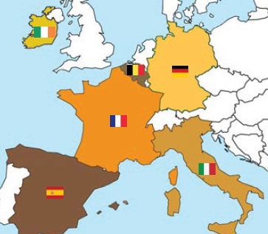








LIFE CARBON FARMING – key figures
2021 – 2027
40 partners in 6 countries
600 dairy and beef farms involved
Reduction of 15% of farms carbon footprint in 5 years
60 advisors trained to carbon audit tools and carbon certification
Rewarding farmers for their efforts

Slide 3




Steps of a carbon farming project on a farm
Maximum duration: 5 years, revolving project for 5 years
Verification audit by an independant auditor following Label Bas Carbone method
Follow-up visit
Follow-up visit
Project validation
Année 1
Année 2
Année 3
Année 4
Année 5
Année 6
Notification
Recognition of carbon credits
Carbon plan
Final diagnostic
Building of an action plan, choice of practices, objectives and carbon gains
Midterm control
Carbon audit and assessment of the implementation of practices, calculation of the carbon gains compared to year 1
Farm carbon diagnostic
Assessment of practices put in place

Slide 4

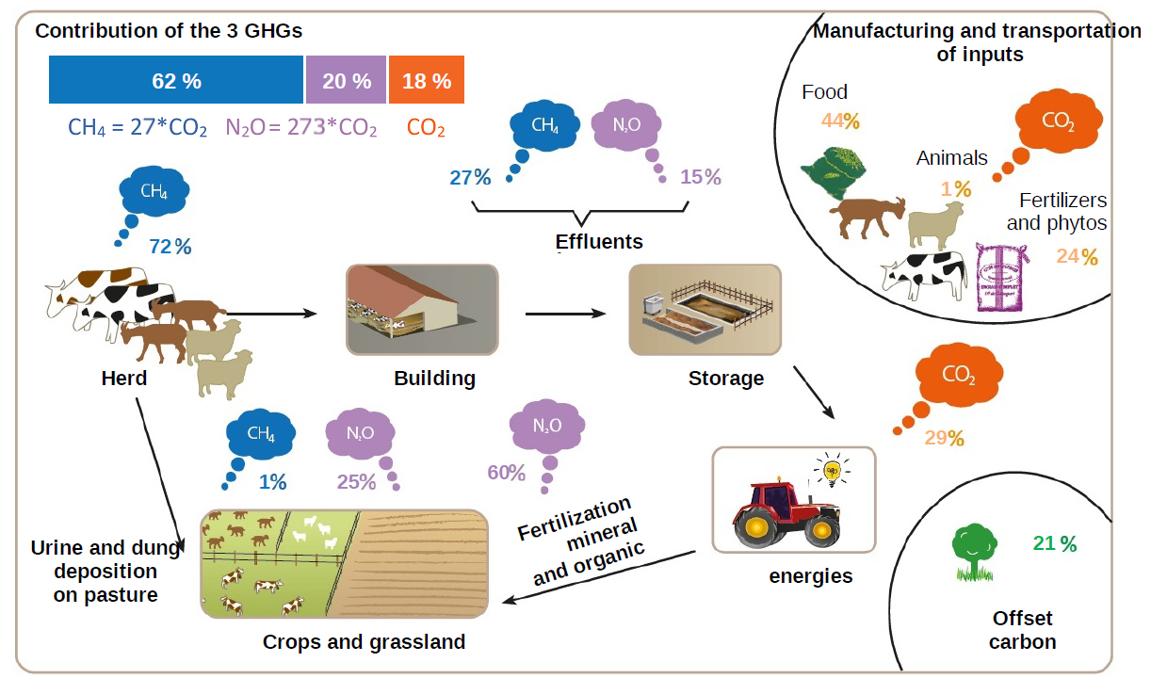

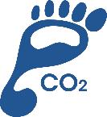
How to measure carbon footprint of farms’ products?
Life Cycle Analysis with a follow-up tool: CAP’2ER for French, German, Belgian and Italian farms.
Tier 2 or Tier 3 to assess emissions on farm’s scale
Emissions are assessed per kg of product.
COVERED REDUCTIONS
Emissions reductions
Carbon sequestration
Indirect emissions reductions
Direct emissions reductions

Slide 5
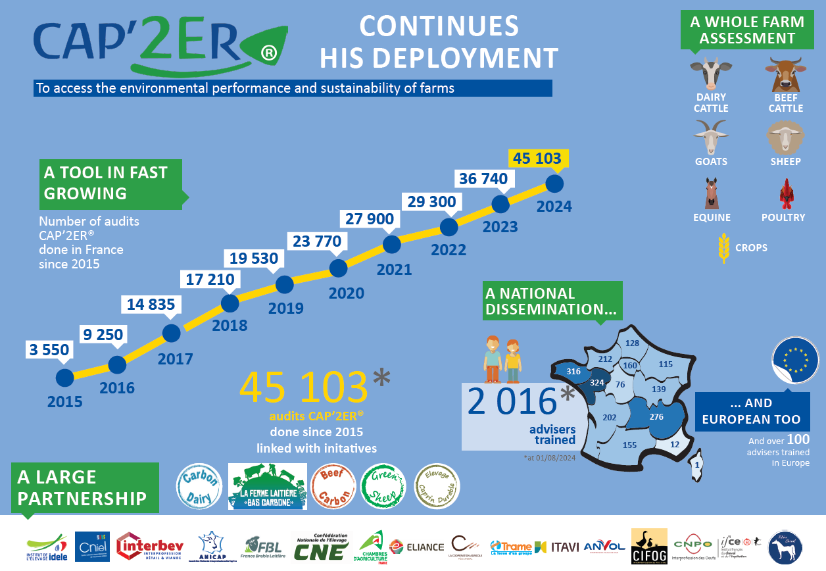
Implementation of cap’2er on farms

Slide 6
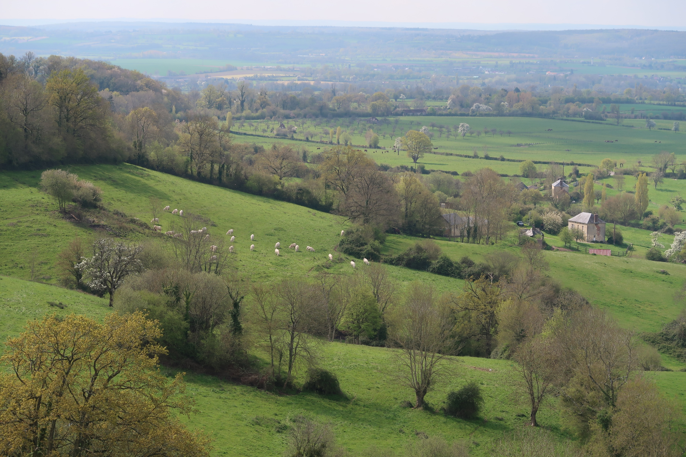
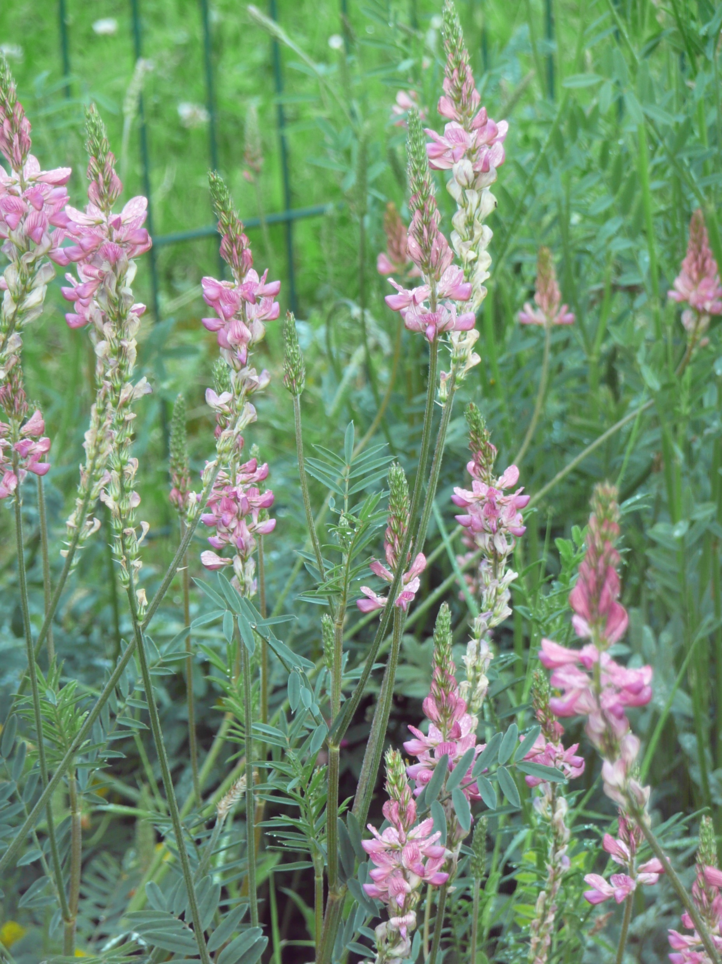
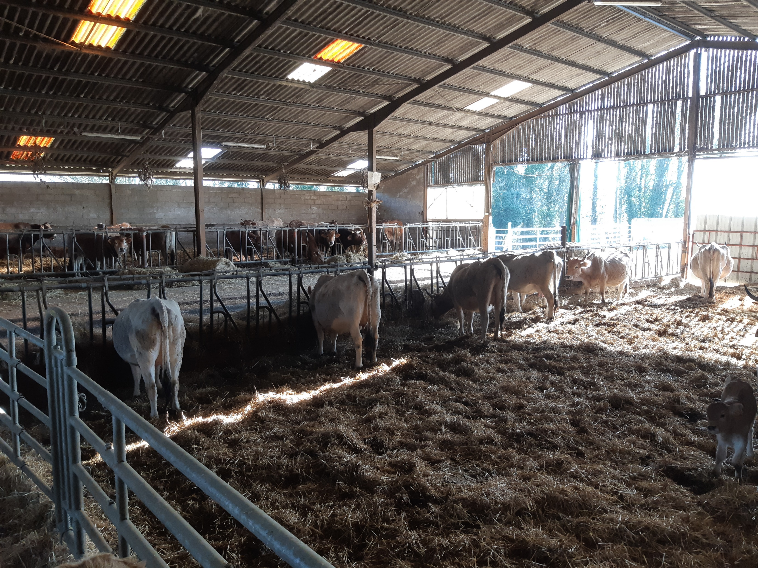
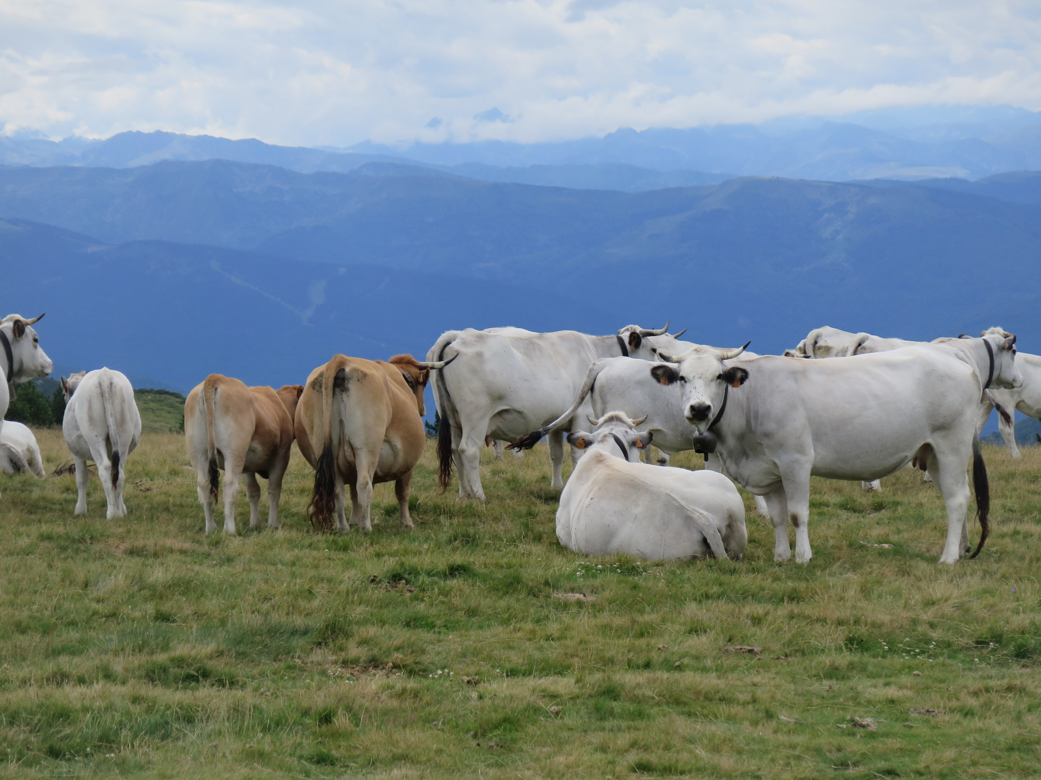
What concrete measures to implement to reduce emissions and store carbon?
Landscape and surfaces
Hedgerows–agroforestry – grasslands and legumes – reducing mineral fertilisation-Direct seeding- Intermediate crops
Feeding
Improving forrages quality, more grazing and less concentrates, protein
Energy and buildings
Reducing electricty and fuel consumption. Biogas plant, manure storage
Herd management
Animals health, housing and heifers breeding
→ A whole farm approach to build an efficient mitigation action plan and avoid leakage

Slide 7
Co-benefits of carbon farming projects
Water quality: excess of nitrogen balance → kg N
Air quality: amount of NH3 spread in the air → kg NH3
Energy consumption: direct and indirect energy → MJ
Agronomy: plants cover, irrigation
Biodiversity → ha eq of biodiversity
Energy production → MJ
Deforestation: soya consumption
Direct distribution

Slide 8
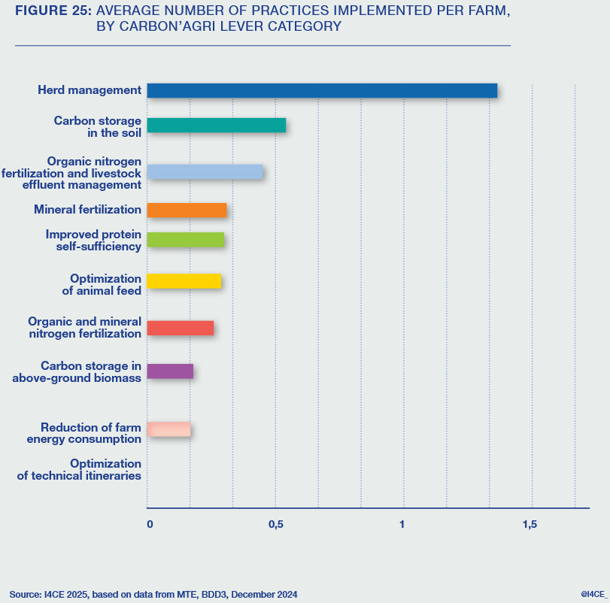
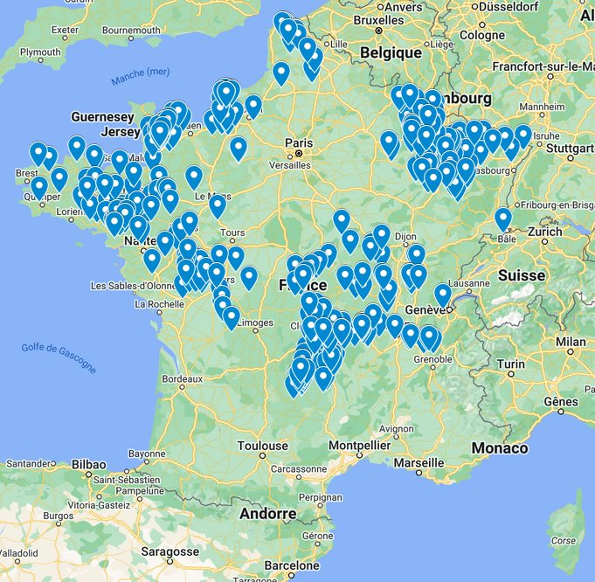
First results of french farms
- Average hectarage = 170 ha including 114 ha of fodder area and 55 ha of cash crops
- 164 Livestock units
- Stocking rate: 1,6 LU/ha of fodder area
321 LIFE Carbon Farming farms in 9 regions:
129 dairy farms
100 beef farms
92 mixed farms
On average, 600 tCO2eq should be avoided per farm with an average baseline of:
1,06 kgCO2eq/L of milk
18,3 kgCO2eq/kg of live meat (suckling farms)

Slide 9
Economic impact of carbon farming projects: a limitation to the implementation on farms?
Behind the costs to put in place practices on farms, several hidden costs should also be taken into account in carbon farming project, including the risk taken by the farmers.
Transition cost
Direct economic impact from Y to Y+5
Products, expenses, investment
Variability due to input/ output economic context
Risk of no /partial realization
Ambitious goals
External factors (climatic hazard, health issues)
Cost of the steps to put into place a practice
Additional work to try a new practice
Cost for external advice
Improve skills set (training, time)
In partial budget method
Risk cost
Farmers survey

Slide 10
Lessons learned for feeding the CRCF framework
The importance of a holistic approach to include the all the sources of emissions on the farms and upstream (i.e., enteric fermentation and manure management in synergy with soil carbon in cropland and grassland)
→ A whole farm approach for improving farms resilience and sustainability
Methodologies ready to use for quantifying carbon reduction accurately and improving environmental co-benefits
An efficient and shared monitoring and reporting process combining data collection and modelling.
Taking into account limitations that can prevent farmers from implementing carbon farming projects.

Slide 11
Thank you for your listening

