Slide 1
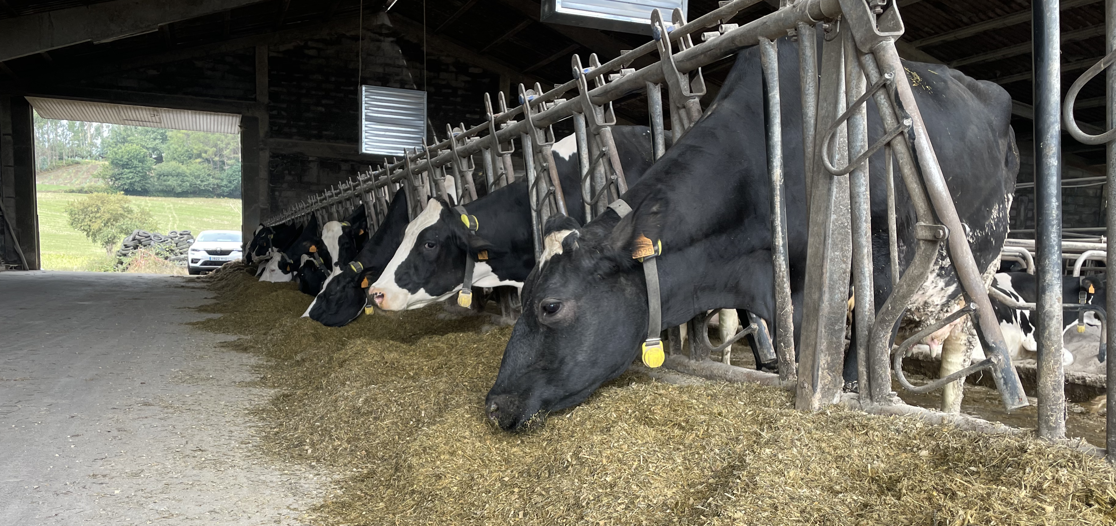



The role of feed additives in reducing livestock emissions
David Yáñez-Ruiz
Spanish National Research Council, CSIC
david.yanez@eez.csic.es
Notes:
Good mornign everone and thank to the organizers for giving the opportinity to contribute to this sesión rtoday. I Will present the main ascpects of the use of feed additievs in relation to the

Slide 2

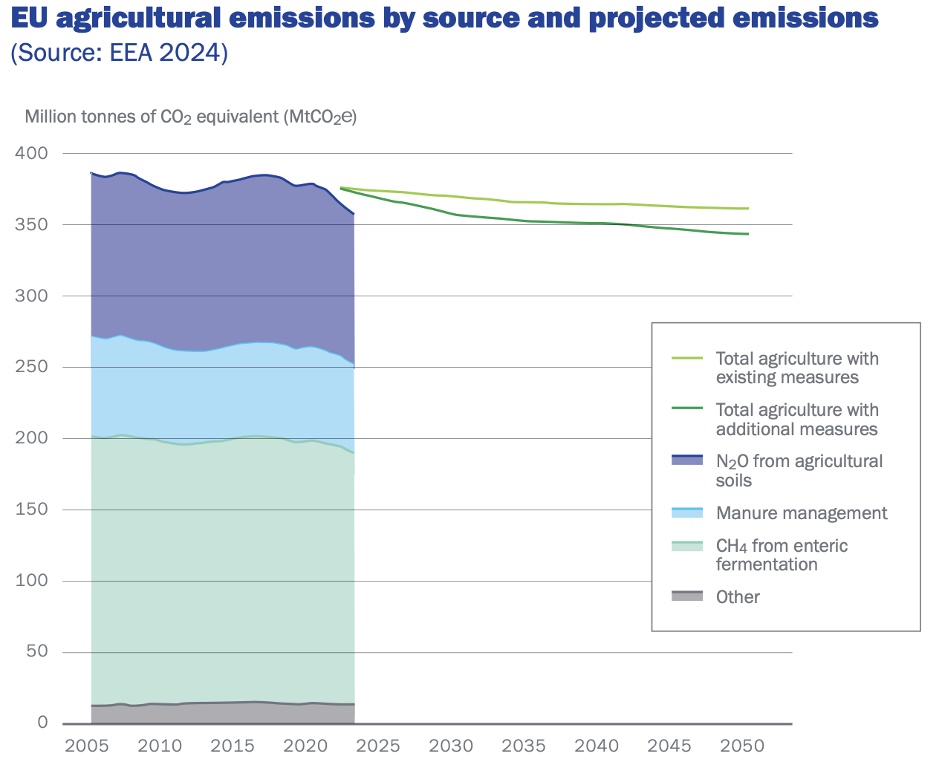
Enteric methane emissions
49 % of total agricultural emissions

Slide 3
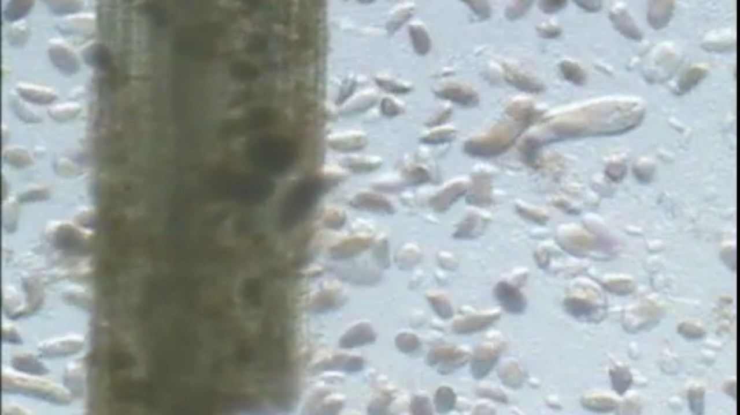


Enteric methane emissions
Methane is not produced by cows …..
but by microbes in their digesitve system
Energy
for animal
CO₂
Carbohydrates
degradation
Methanogenic archaea
CH₄
H₂

Slide 4

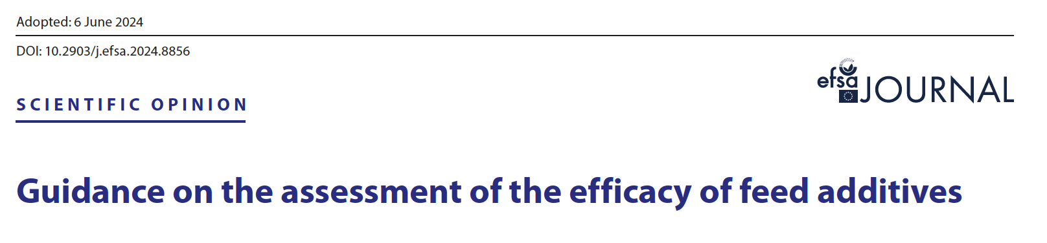
Feed additives
Non-nutritive or nutritional ingredients deliberately added to animal diets—usually in small quantities—to
improve feed quality / boost animal performance / enhance health / reduce environmental impact.
Nutritional: Vitamins, minerals, and amino acids …..
Technological: Preservatives, antioxidants, and emulsifiers that improve feed shelf-life and handling.
Sensory: Flavors and colorants that enhance palatability or product appearance.
Zootechnical: Probiotics (live microorganisms), prebiotics, synthetic compounds and enzymes that enhance digestibility and gut flora.

Slide 5
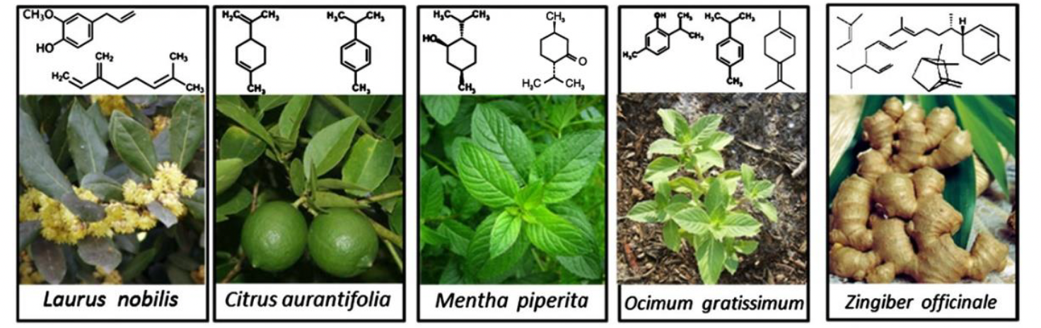
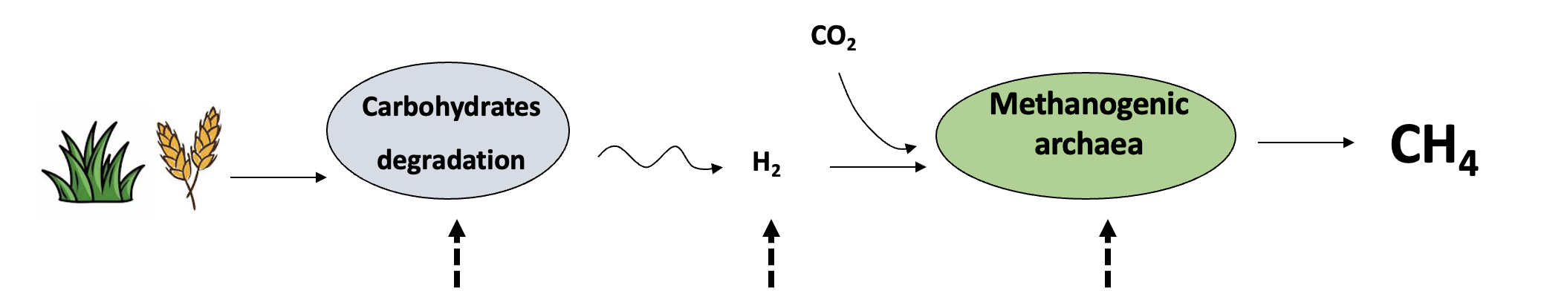
Feed additives
Plant secondary compounds:
Condensed/hydrolysable tannins, saponins, essential oils
Non-specific antimicrobial activity
Varying responses (some positive) ---- 5 % reduction maximum
Several commercial blends, none registered as zootechnical additive to date (some in progress)

Slide 6
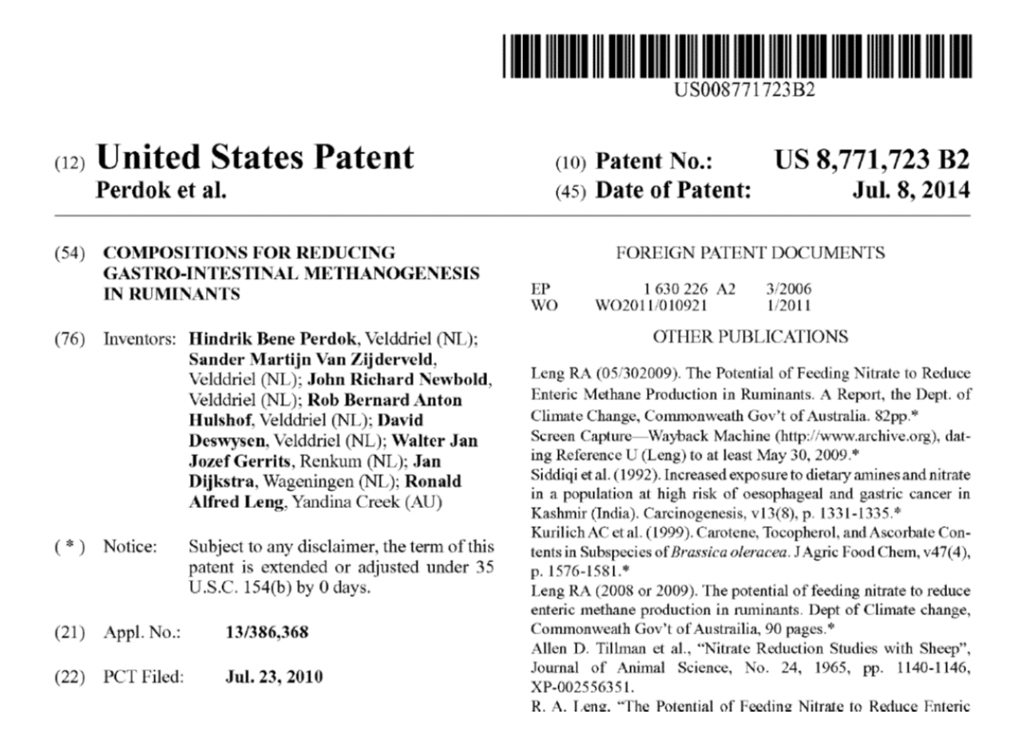

Feed additives
Alternative hydrogen sinks: Nitrate - SILVAIR ®
1 % in the diet --- 10 % reduction methane
Feed ingredient / N supply
Belgium - Australia
NO₃ NO₂ NH₄
Nitrate Nitrite Ammonia
H₂
H₂

Slide 7

Feed additives
Methanogenic archaea inhibitors:
Bovaer®
3-NOP
3-nitrooxypropanol
1.2 g /animal ---- 30 % consistent reduction methane
Approved 2022 as zootechnical additive (only one in EU)---- dairy to date – used in 10 EU countries
117 scientific studies published
Bromoform seaweeds ????

Slide 8
Feed additives ----- challenges
No direct benefit for the farmer in some cases --- support/combination of additives
Farmers
Consumers
Social media campaigns against feed additives / climate change actions

Slide 9
Feed additives
Farmers
Consumers
Solid evidence to reduce enteric methane emissions (5-30 %)
(more solutions being developed)
Are we accurately accounting for such reductions in the EU?
Challenges linked to adoption/implementation (costs, educational,….)

Slide 10


Thank you
david.yanez@eez.csic.es

