Slide 1
EU Parliament’s Sustainable Livestock Intergroup Meeting
Brussels | 28 January 2026
Livestock at the Crossroads
United to drive Sustainable Livestock Transformation for Better production, Better Nutrition, Better Environment, and a Better Life, leaving no one behind
Thanawat Tiensin
Assistant Director−General
Director of Animal Production and Health Division
Chief Veterinarian
Food and Agriculture Organization of the United Nations

Slide 2
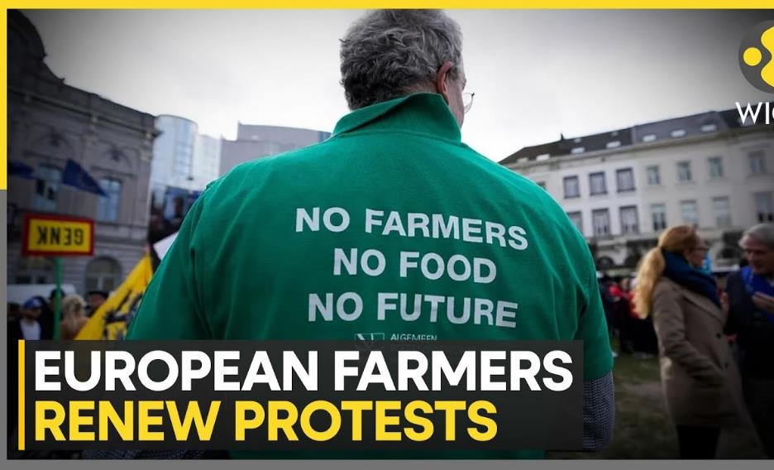
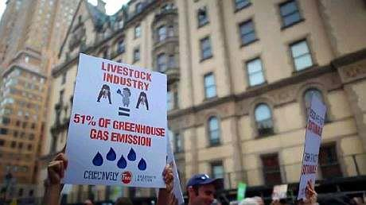
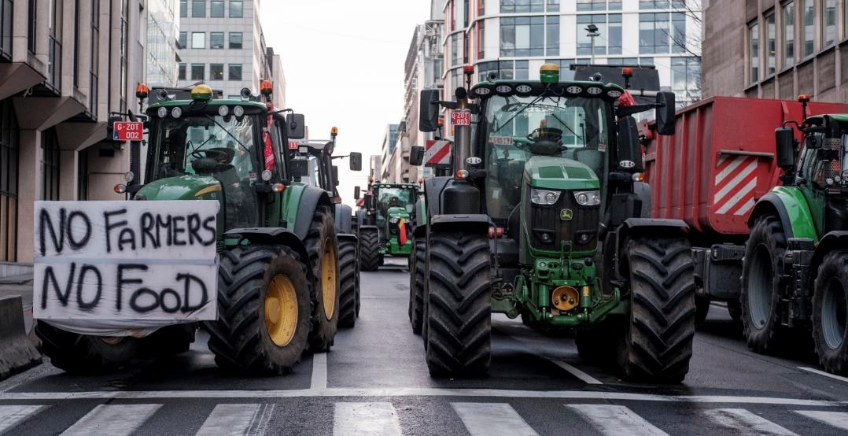
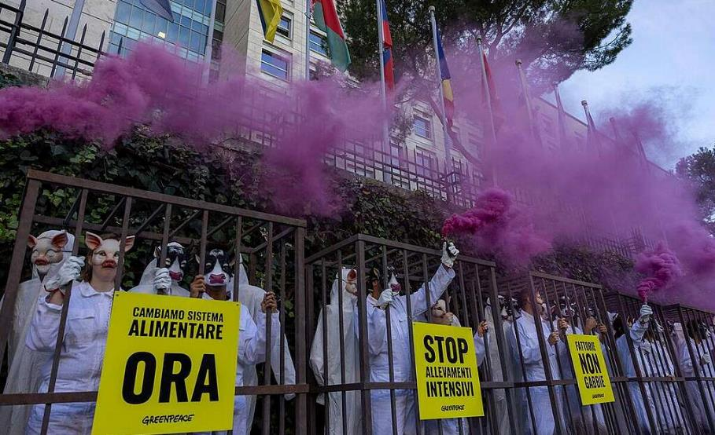

Slide 3
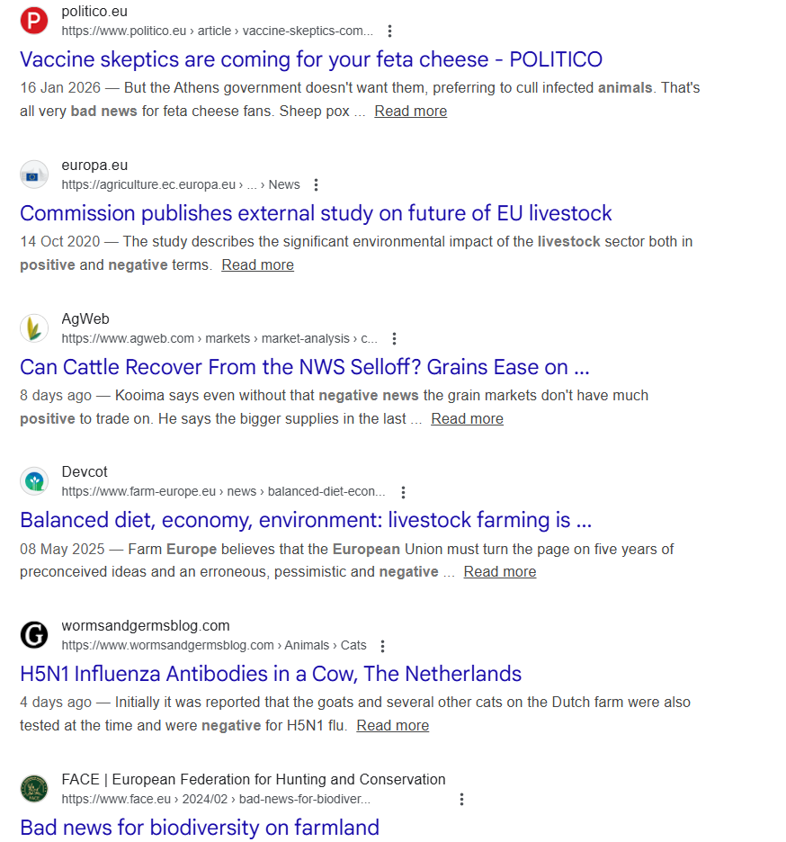
Under pressure: EU livestock farmers face rising costs, environmental and climate requirements, animal health risks, and volatile markets.
High policy and societal expectations: High demands for improved sustainability, emissions reduction, and animal welfare are rising faster than on-farm transition support.
Economic fragility: Profit margins are tight, especially for small and family farms, increasing the risk of farm closures.
Generational challenge: Fewer young people are entering livestock farming due to workload, income uncertainty, and social perception.
Strategic importance: Livestock remains essential for EU food security, rural economies, landscape management, and agrifood system resilience.

Slide 4
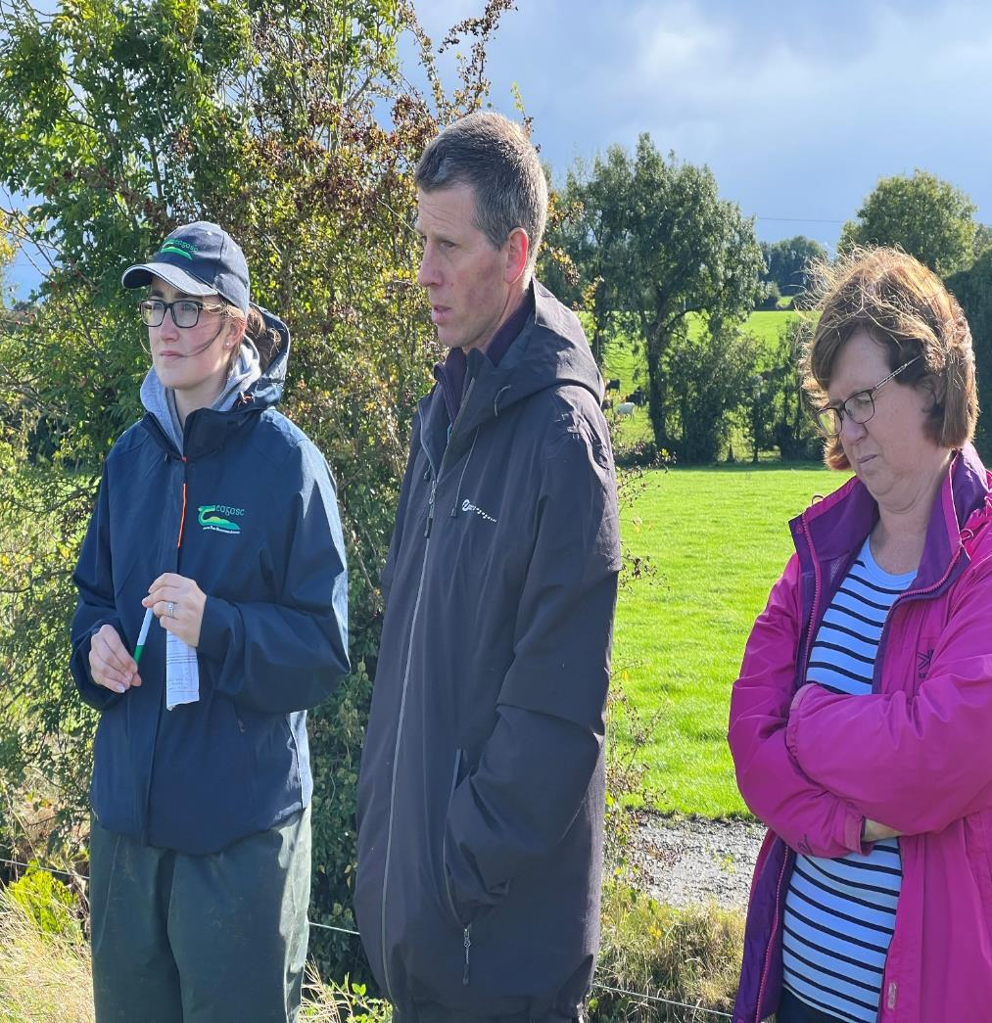
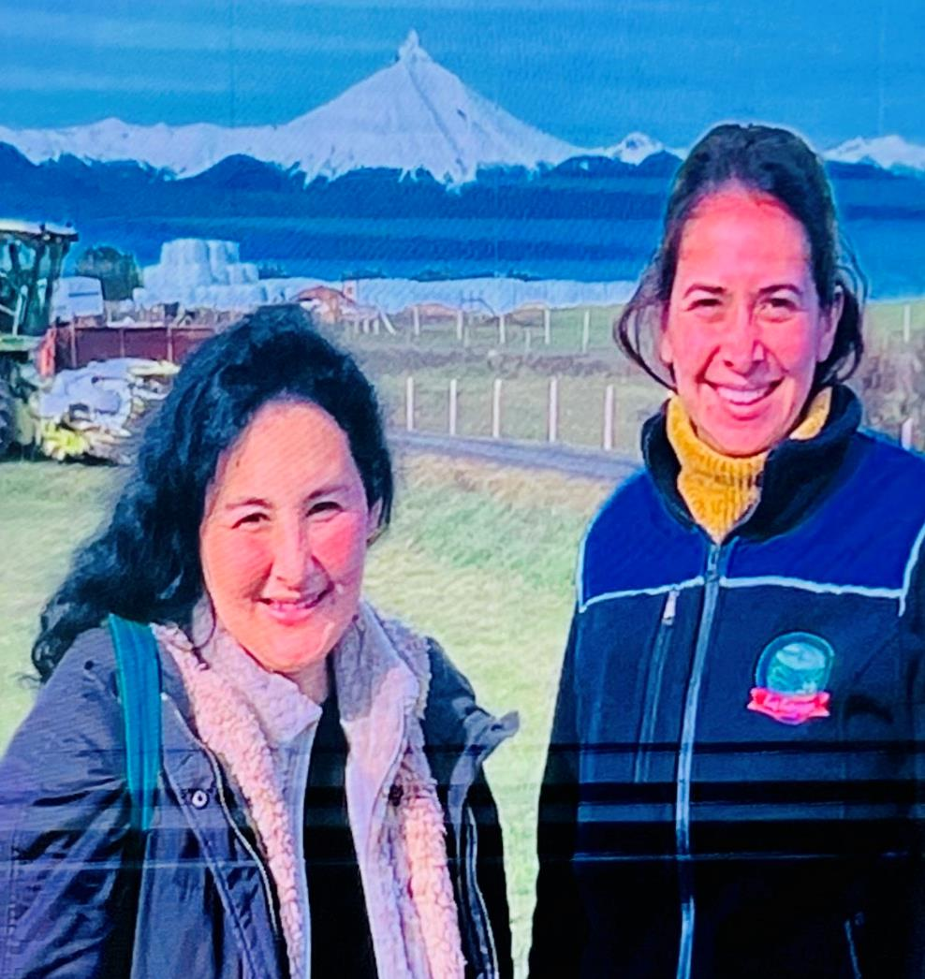
We are the problem or We are the solution!

Slide 5
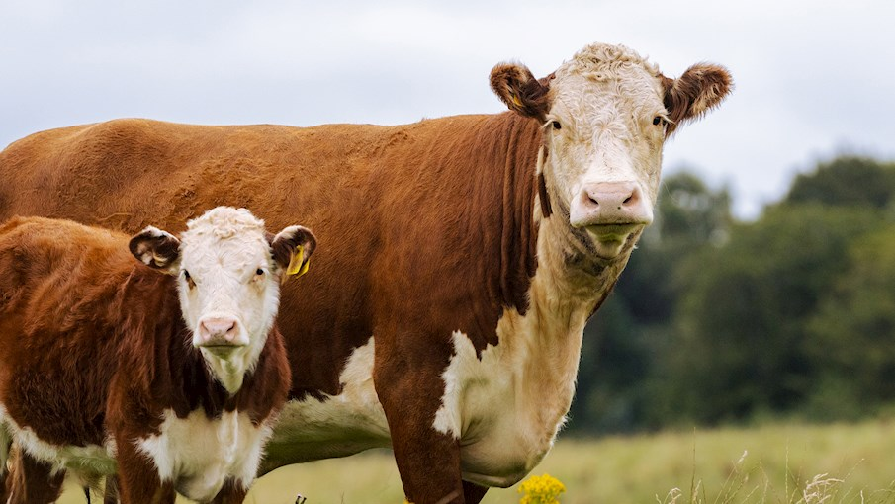
What are the challenges?

Slide 6
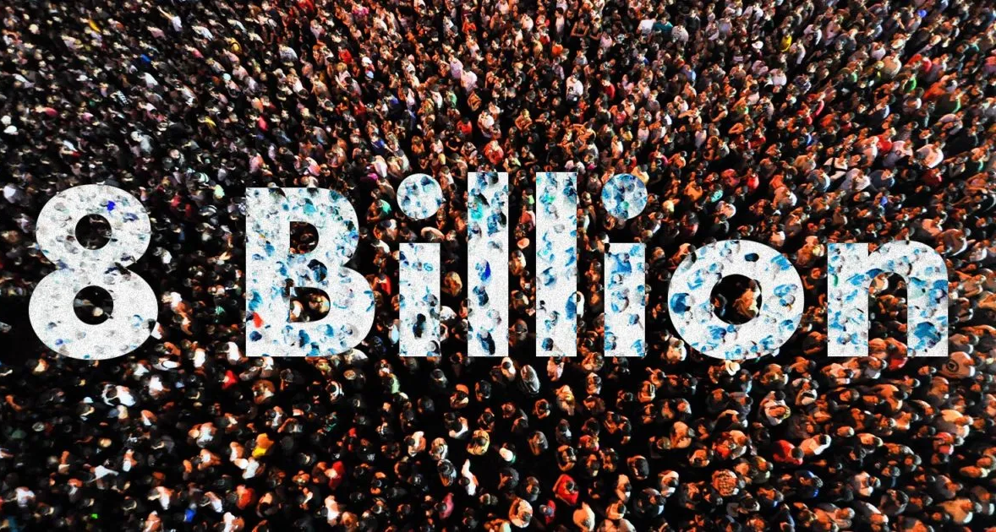
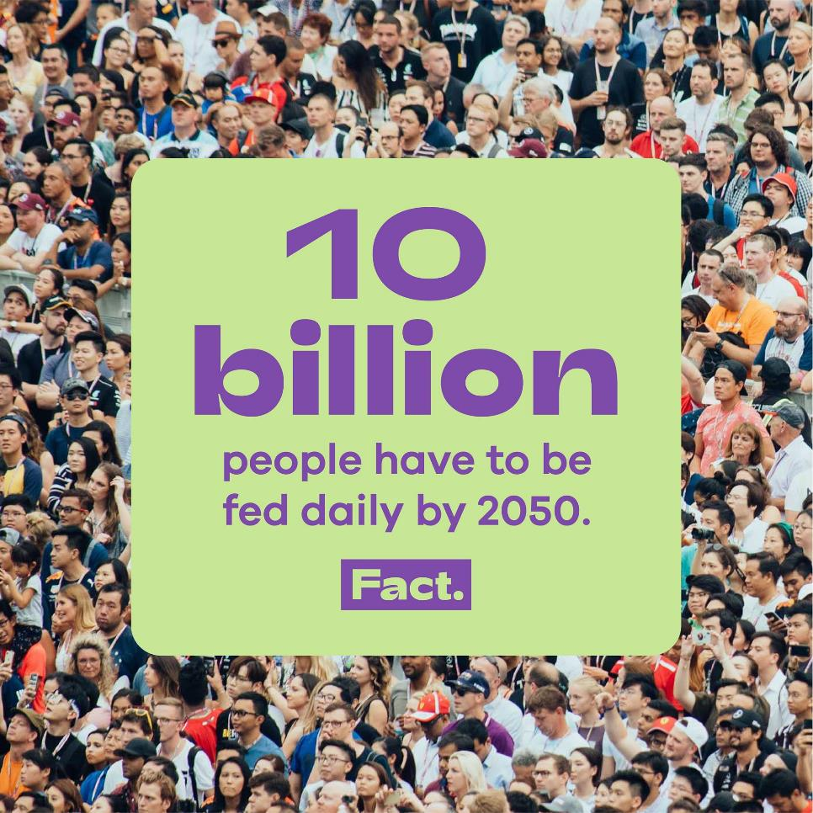
Feeding people is our challenge
Today
While unhealthy and unsafe diets are linked to at least 8 million deaths per year. “Malnutrition in all its forms is one of the world’s leading causes of death and illness.”

Slide 7




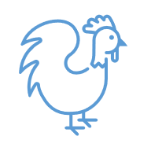
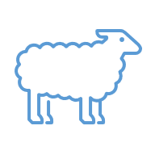
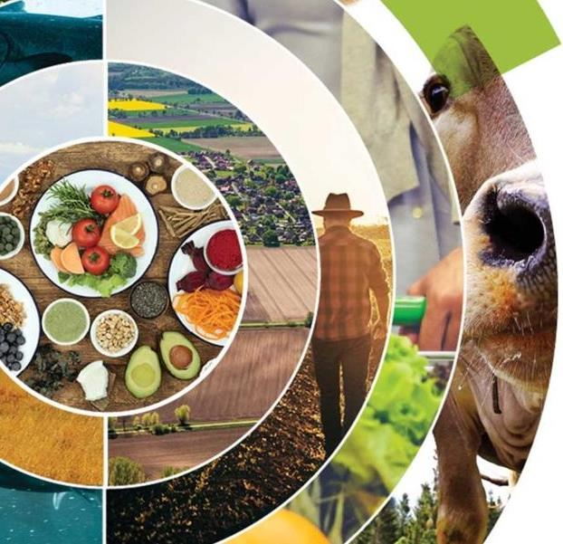
Today's Challenges for Agrifood & Livestock Sectors
🌾 Productivity vs. Sustainability
Increased food outputs with less environmental impacts - soil degradation, water scarcity, and emissions.
🛒 Fragmented & Inefficient Supply Chains
Post-harvest loss, lack of cold storage, low prices for farmers & producers, & high prices for consumers.
👨‍🌾 Aging Farmer Population & Rural Poverty
Youth are migrating away from agriculture, leading to an aging workforce, threatening future food production.
🌍 Climate Change Vulnerability
Increasingly frequent and severe droughts, floods, weather pattern changes impacting yields and food security.
🥗 Changing Diets & Health Concerns
Rapid urbanization is driving a shift towards processed foods, contributing to malnutrition, undernutrition & rising obesity.

Slide 8


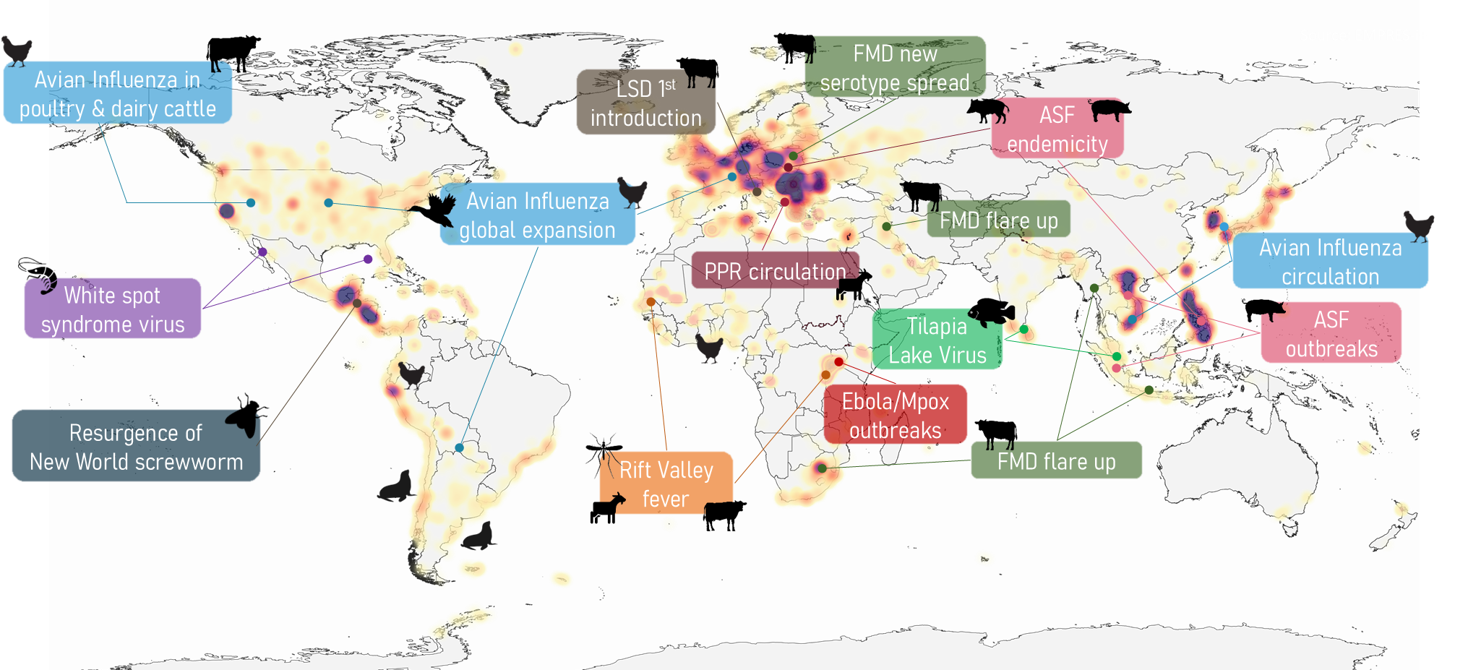
The current situation
ASF – African swine fever
FMD – Foot-and-mouth disease
PPR – Peste des petits ruminants
LSD – Lumpy skin disease
Transboundary animal diseases do not respect borders!
Source: FAO Emergency Prevention System for Transboundary Animal Diseases (EMPRES)
Notes:
Existing and emerging Transboundary Animal Diseases (TADs) are spreading faster and farther—driven by intensified trade, animal movement, wildlife interactions, and climate factors—causing massive losses.
Recent examples include the global spread of High Pathogenicity Avian Influenza (HPAI), transregional spread of novel strains of foot and mouth disease (FMD), the resurgence of New World Screwworm (NWS), the emergence of African Swine Fever (ASF), the expanding range of Rift Valley fever (RVF), and aquatic diseases like Tilapia Lake virus and Infectious Salmon anemia

Slide 9

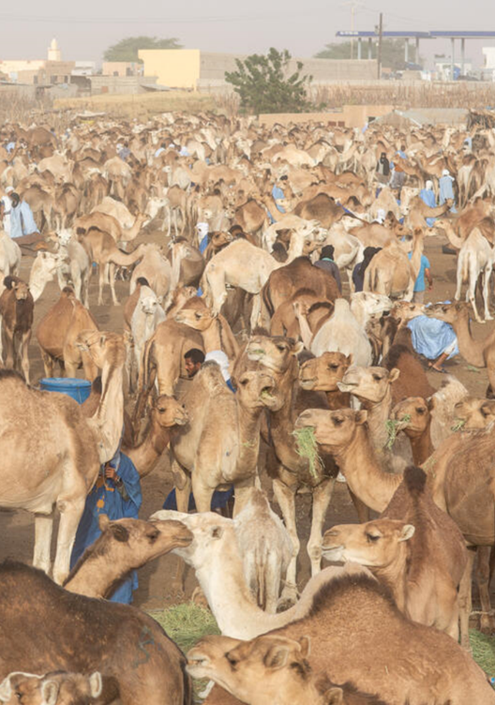
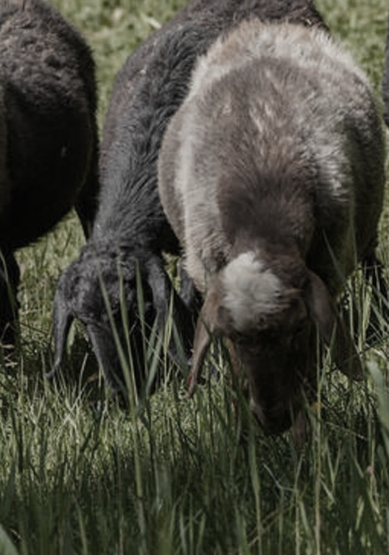
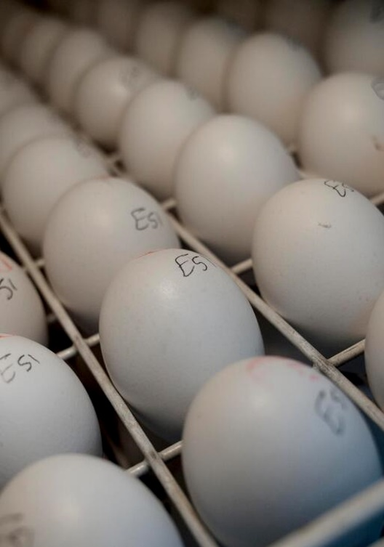
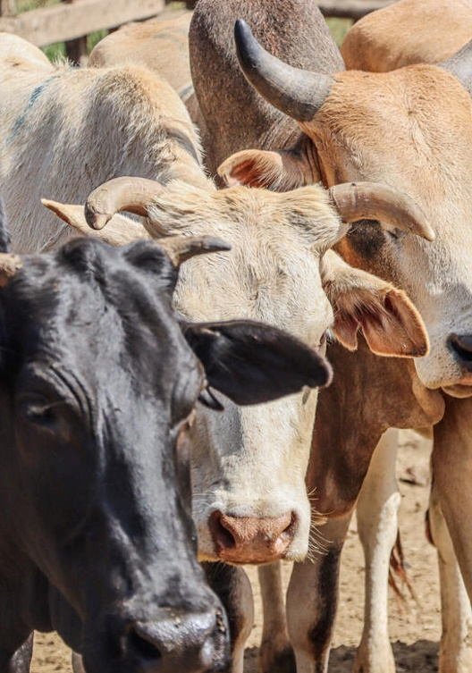
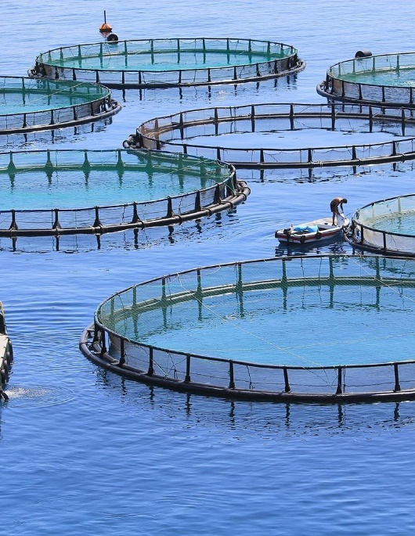
What’s at stake?
By 2050, livestock production and aquaculture are expected to grow by ~20%
Loss of
usd 48 - 330 billion
Livelihoods of
1.9 billion
people
Loss of
usd 10 billion
usd 1.6 - 3.3 trillion
75%
is the global market value of farmed animals
is the cost if 3% to 10% is lost due to TADs
of emerging infectious diseases are zoonotic
depend on terrestrial & aquatic animal
value chains
due to infectious diseases in aquaculture
Notes:
References
Expected growth:
Livestock production growth by 20% to meet the demand - FAO. 2023. Pathways towards lower emissions – A global assessment of the greenhouse gas emissions and mitigation options from livestock agrifood systems. Rome https://doi.org/10.4060/cc9029en
Supply in aquatic animal foods growth by 22% to sustain current per capita consumption - FAO. 2024. The State of World Fisheries and Aquaculture 2024 – Blue Transformation in action. Rome. https://doi.org/10.4060/cd0683en
Global market value of farmed animals:
1.6 and 3.3 USD trillion (adding up the annual global asset value (USD 1.7 trillion) and annual output market value (USD 1.6 trillion)) provides an approximation of the annual total global economic value of farmed animals for 2018. Schrobback, Peggy, et al. "Approximating the global economic (market) value of farmed animals." Global food security 39 (2023): 100722.
Loss due to TADs
If we use the annual value of livestock output (1.6 trillion) and the lower bound on the impact of TADs (3%), we get USD 48 billion.
If we use both the annual value of livestock output and the annual global asset value (1.7 trillion) + the higher bound on the impact of TADs (10%) we get 330 billion
Emerging infectious diseases that are zoonotic: 75% of emerging infectious diseases are zoonotic – WOAH (2024). The Importance of the One Health Approach in Tackling Emerging and Re-emerging Zoonotic Epidemics and Pandemics. https://doi.org/10.20506/woah.3480
1.9 billion people employed in terrestrial and aquatic animal value chains
1.3 billion people employed in terrestrial animal value chains - Alders, Robyn G., et al. "Livestock across the world: diverse animal species with complex roles in human societies and ecosystem services." Animal Frontiers 11.5 (2021): 20-29.
0.6 billion livelihoods depend on fisheries and aquaculture – FAO (2022). The State of World Fisheries and aquaculture. https://openknowledge.fao.org/server/api/core/bitstreams/9c3ed6a3-c2de-4e4b-b315-9ad6891d8d11/content
Conservative estimates suggest that 10 percent of all cultured aquatic animals are lost on a global scale, because of infectious diseases alone, amounting to over 10 billion USD in lost revenue annually
Shinn, A. P., Pratoomyot, J., Bron, J. E., Paladini, G., Brooker, E. E., & Brooker, A. J. (2015a). Economic impacts of aquatic parasites on global finfish production. Global Aquaculture Advocate, 5, 82–84.
Subasinghe, Rohana, et al. "Biosecurity: Reducing the burden of disease." Journal of the World Aquaculture Society 54.2 (2023): 397-426.

Slide 10
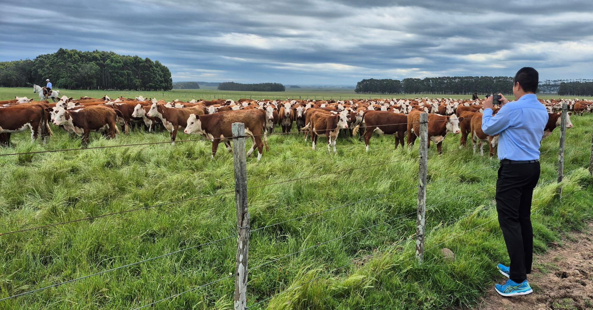
Happiness is our concern
Happy animals
Happy employment..!

Slide 11
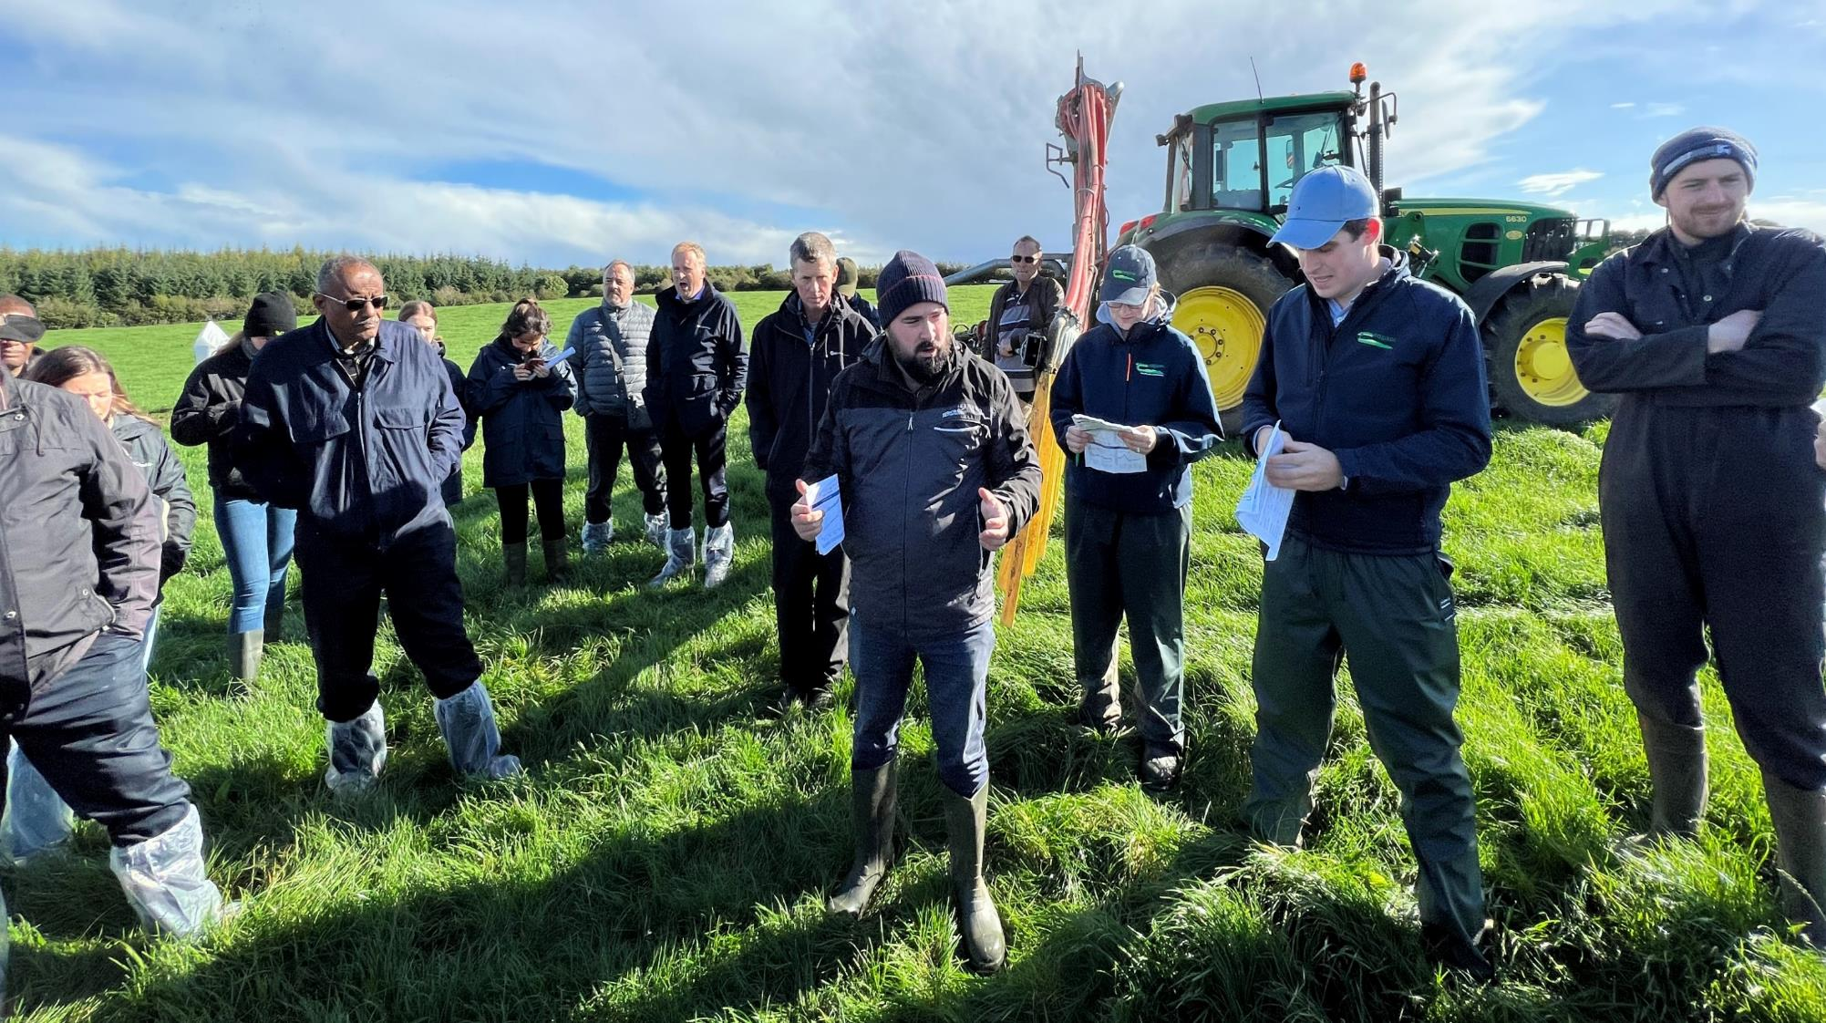
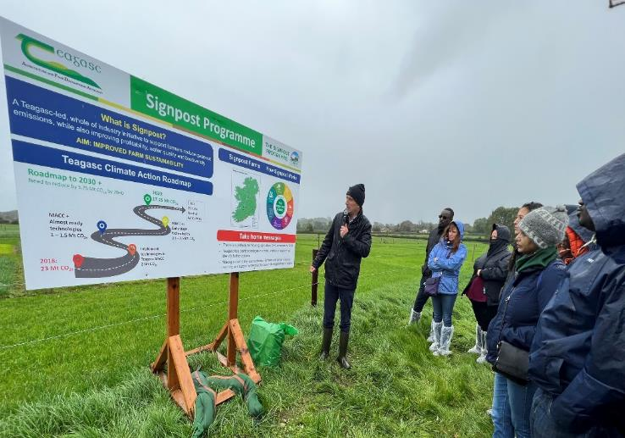
“Pathways to Actions”
Ireland

Slide 12
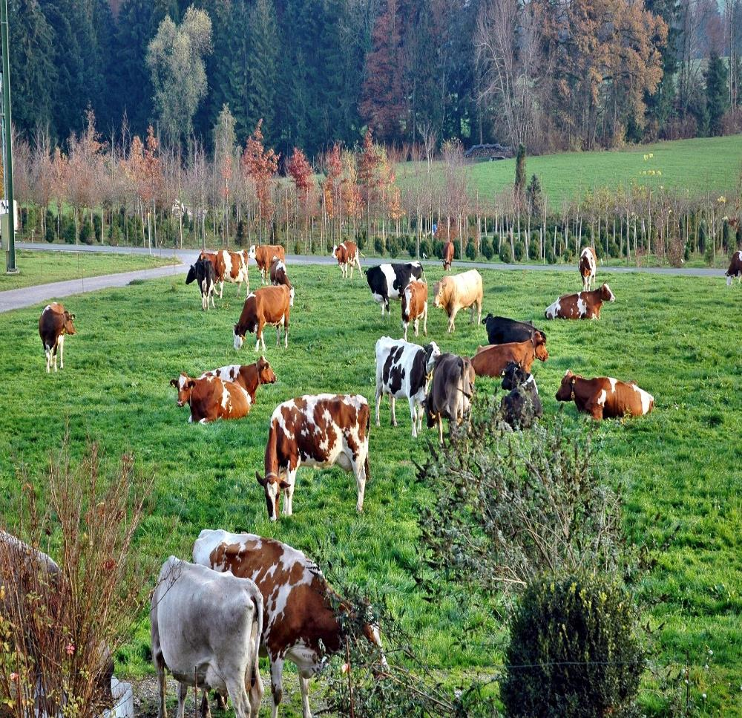
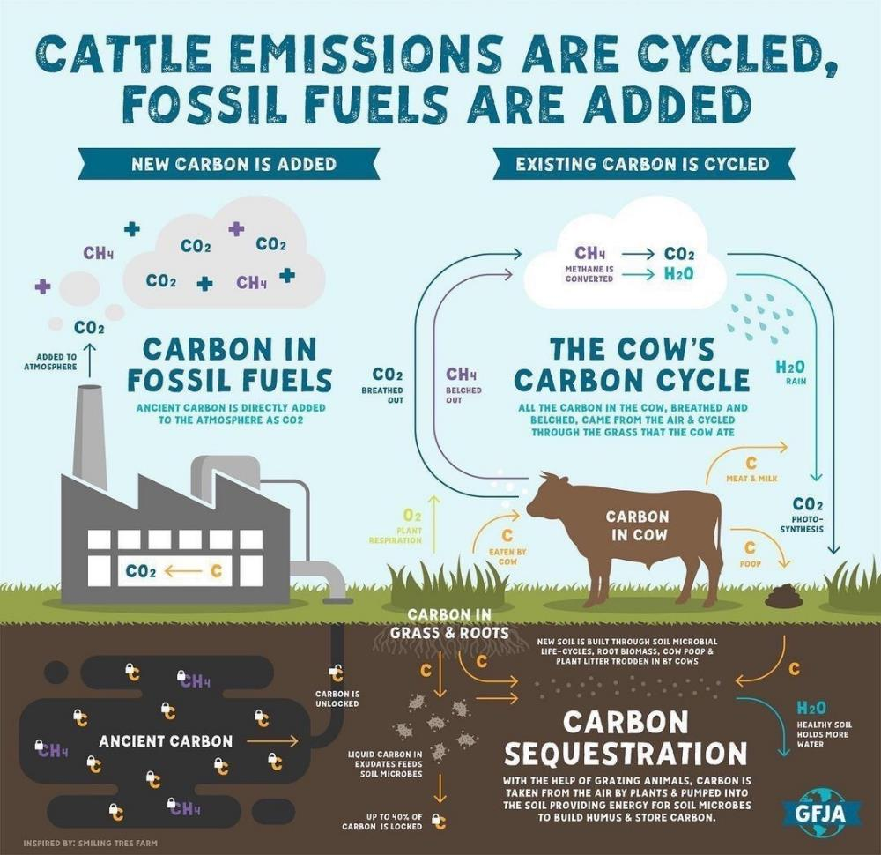
Only about 3% of Norway's total land area is arable; 2% of this land is grassland.
Norway

Slide 13
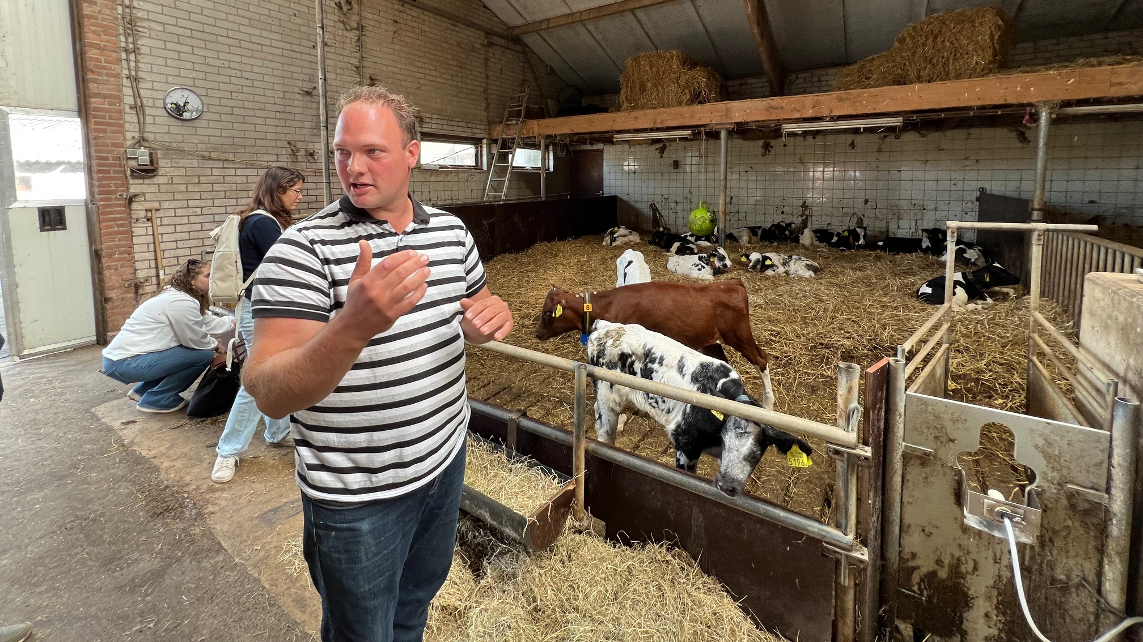
I open my farm to the public every weekend so people can see how I care for my animals,
how I manage and protect my land, and
how I ensure the welfare of my calves.
Netherlands

Slide 14
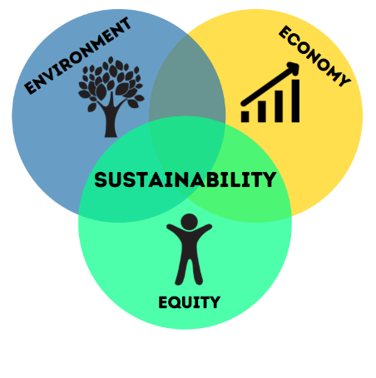

Right Balance of Sustainability?
Food Security
Nutrition
Sustainability has no single path — each country must shape its own journey, guided by its people, priorities, and context, yet united by a shared vision for a better future.

Slide 15
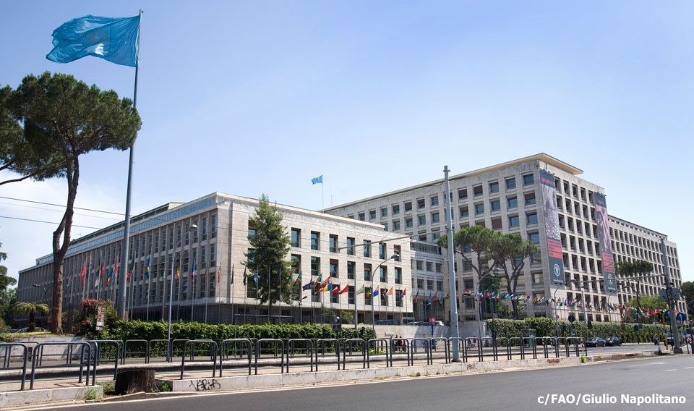
How can FAO collaborate with you?

Slide 16
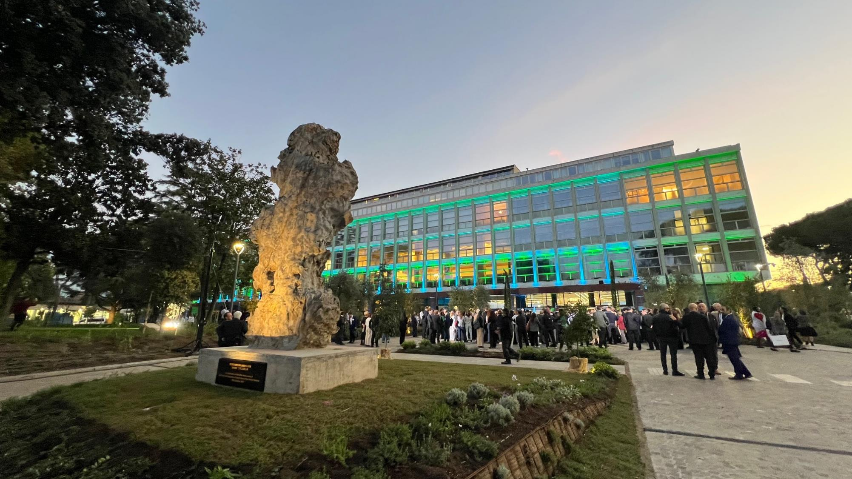
Our New FAO – Your Organization

Slide 17
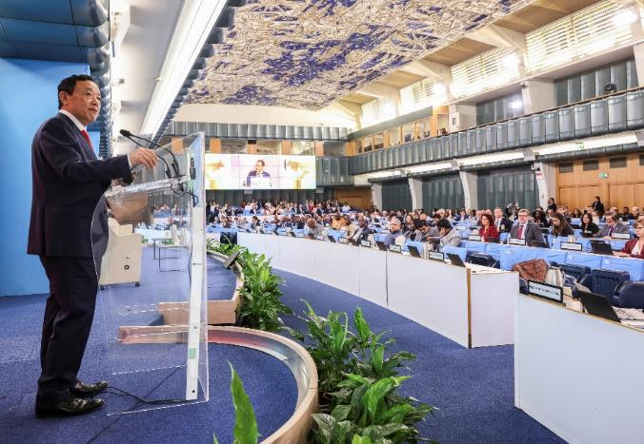
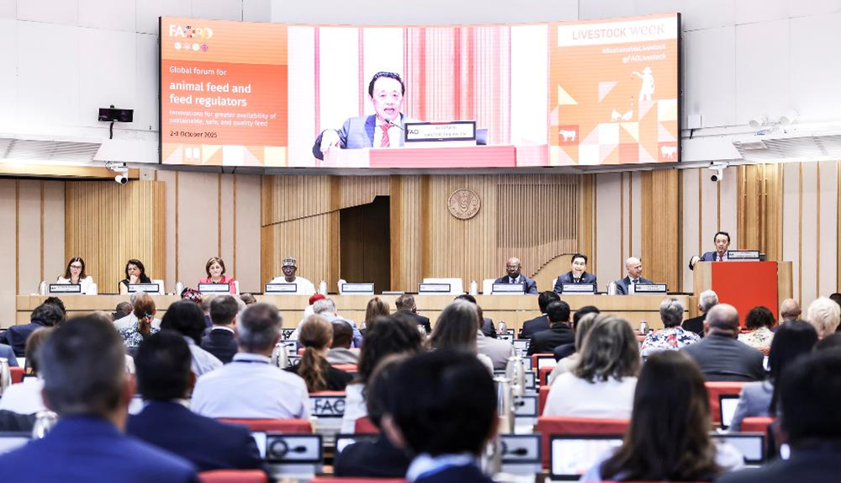
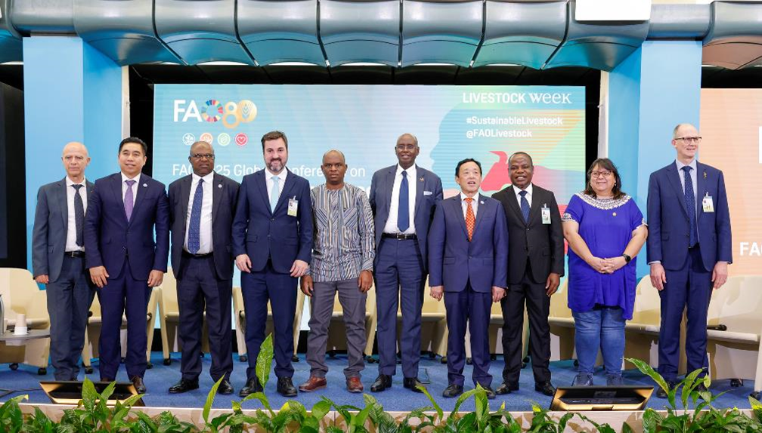
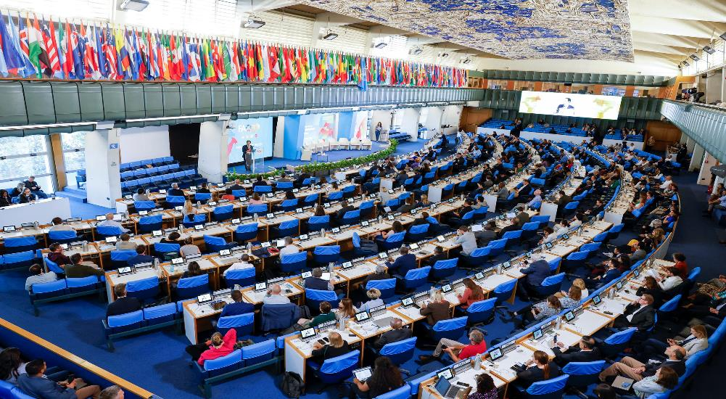
FAO Sustainable Livestock Week 2025
Global Conference on Sustainable Livestock Transformation
Global Forum for Animal Feed & Feed Regulators
CEO Sustainable Livestock Summit
Over 1,200 in-person participants

Slide 18
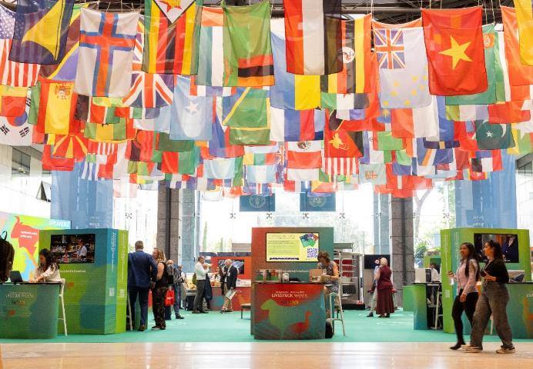
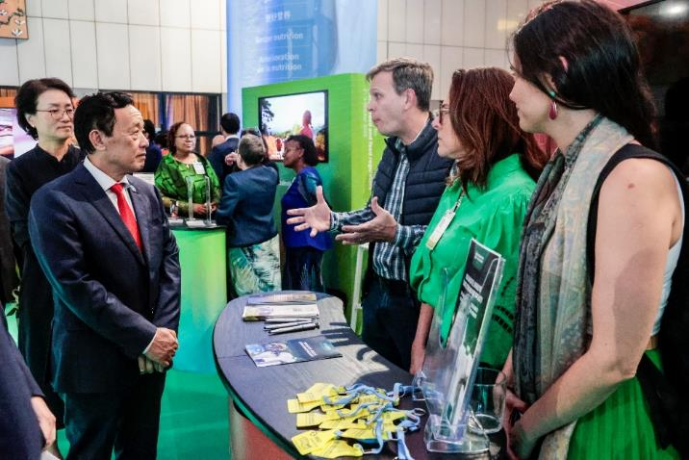
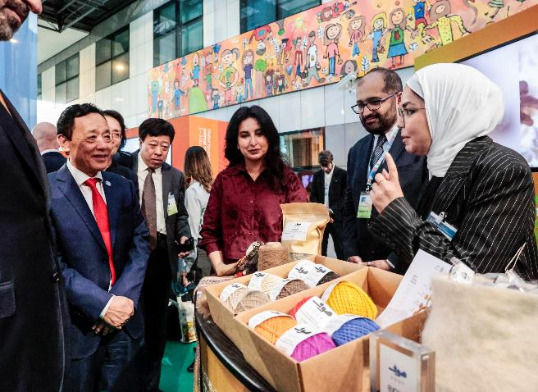
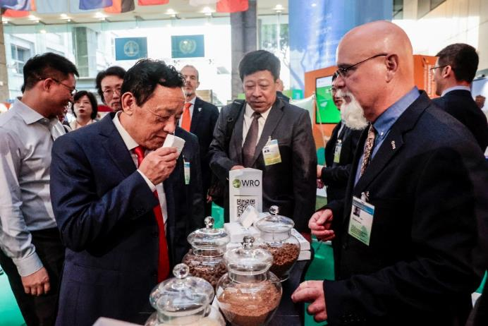
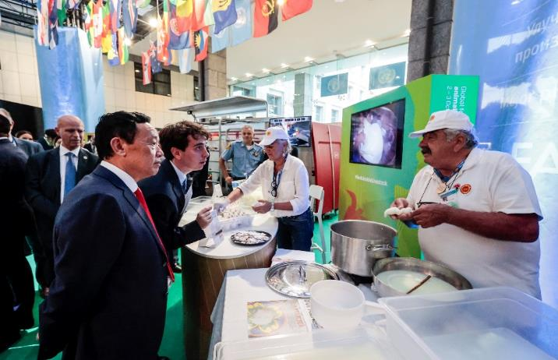
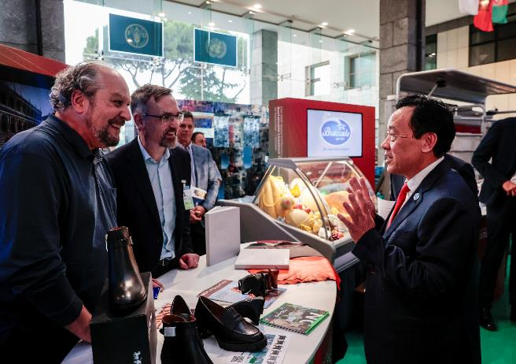
Sustainable Livestock Innovation Exhibition

Slide 19
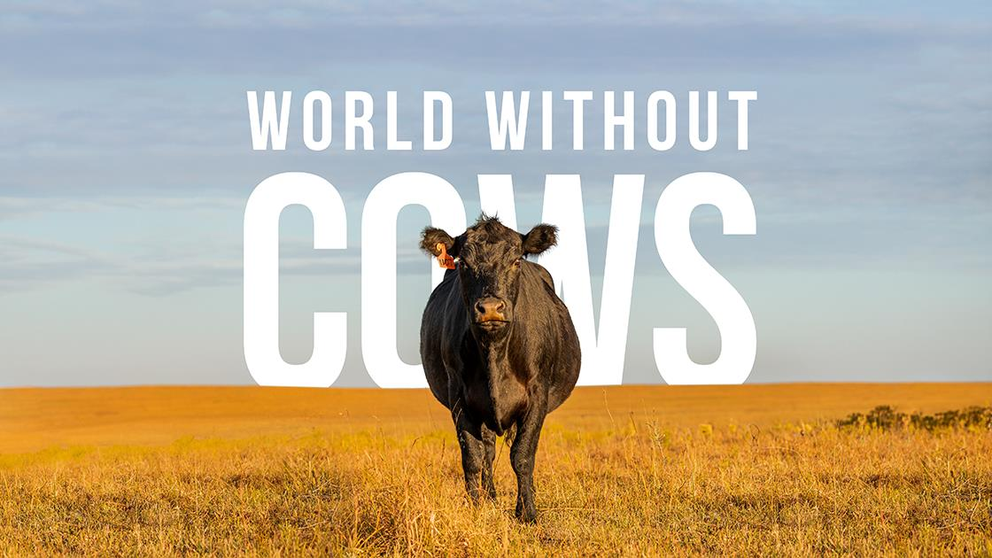
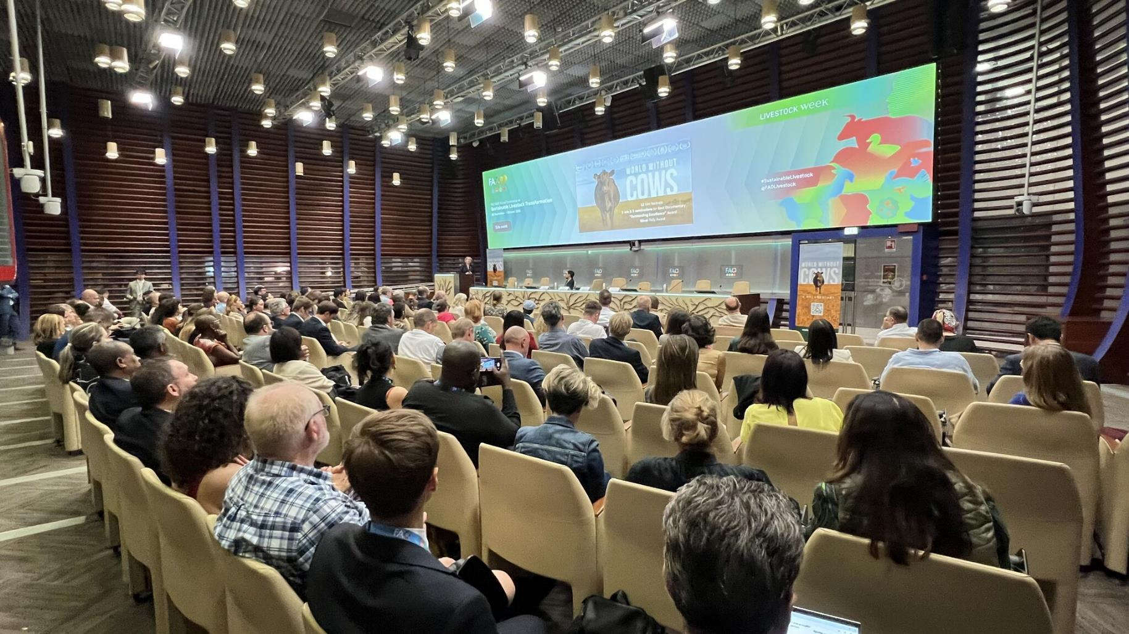

Slide 20
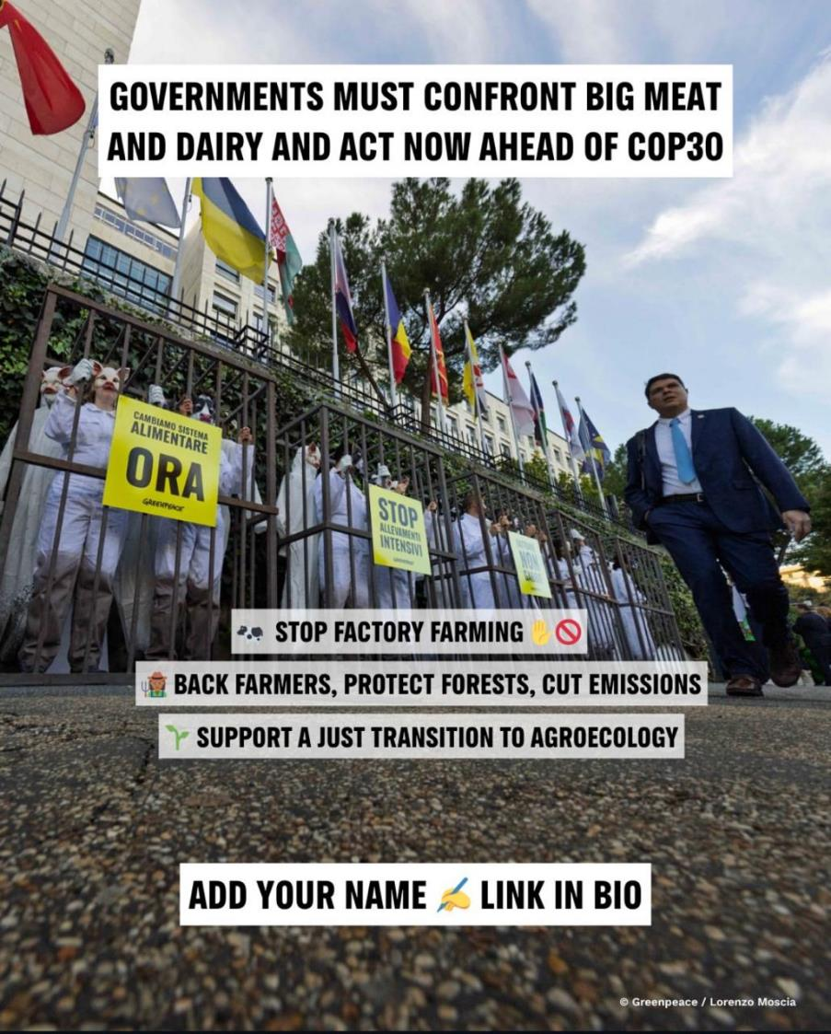
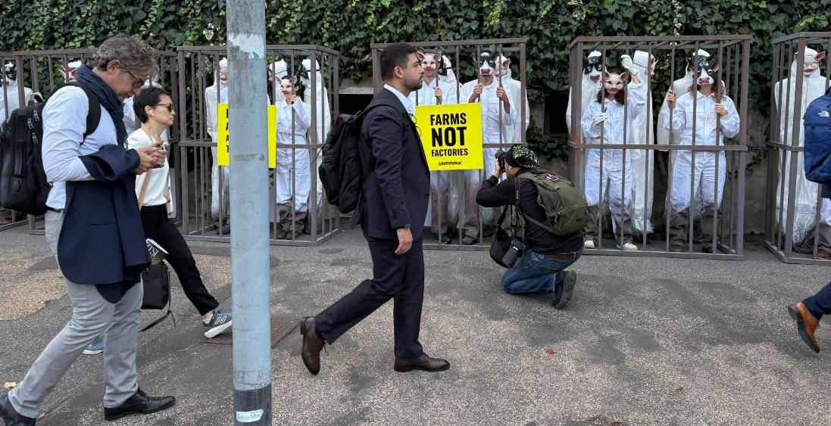
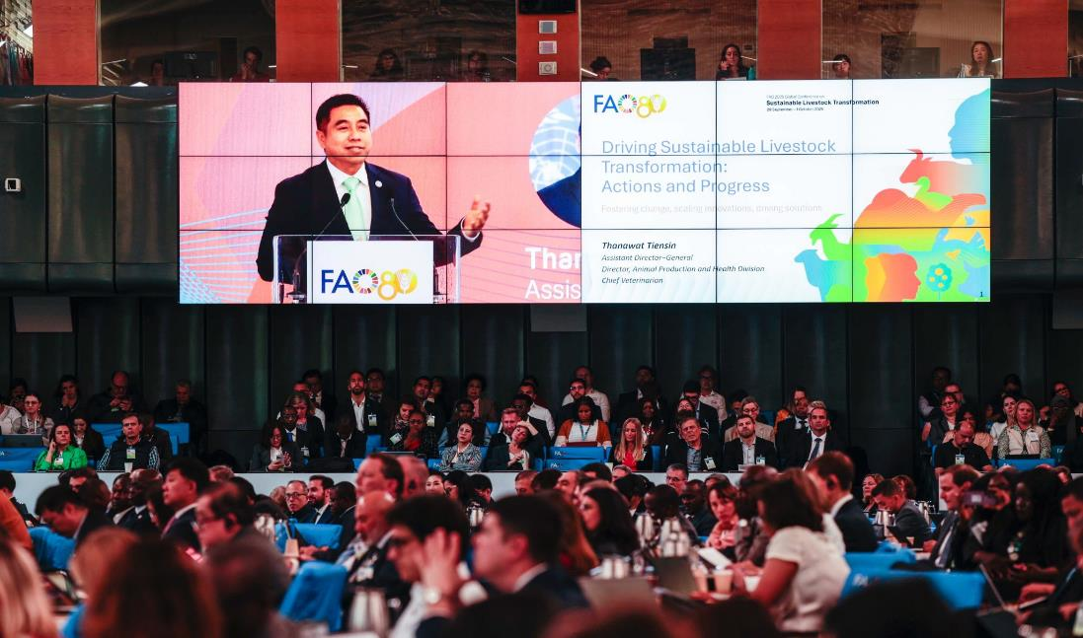

Slide 21
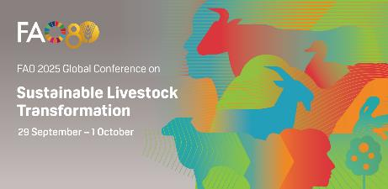
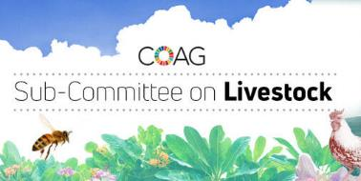
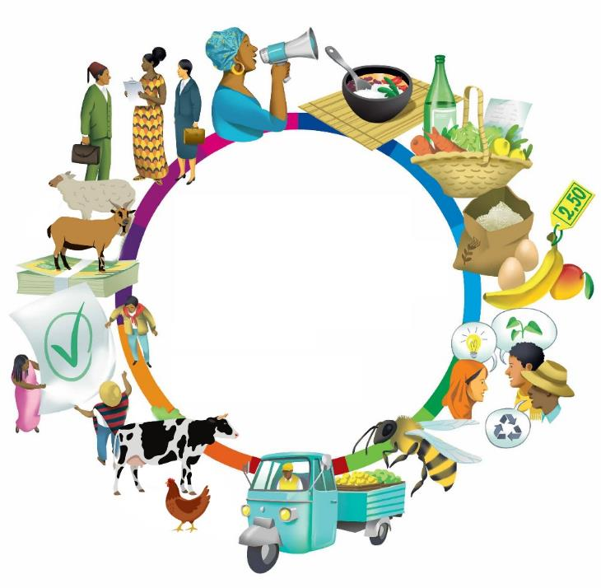



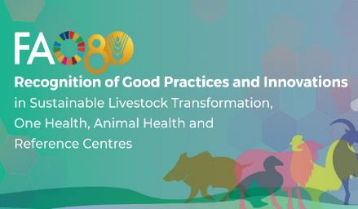

Global Landscape Changes in Livestock
But we can do better! This is our commitment
Better Production, Better Nutrition, Better Environment, and a Better Life.
Global Governing Body
Livestock sectors, we are part of agrifood systems.
We bring solutions
High-level Expert and Advisory Panel
“Farm 5G”
Multistakeholder Platform

Slide 22
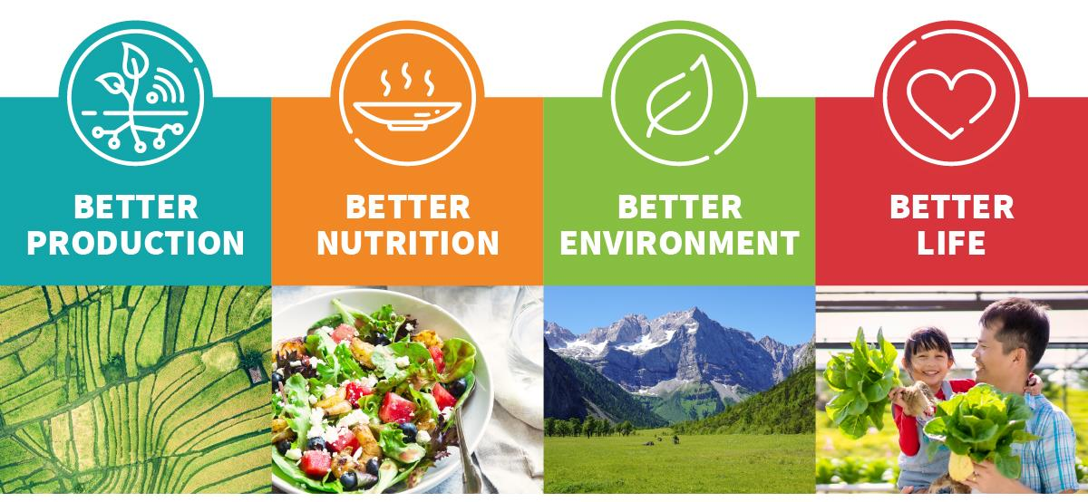
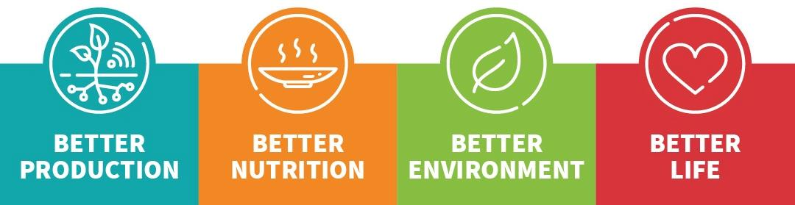
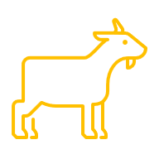
















What do we want to achieve?
Sustainable livestock sector that satisfies global demand for animal source foods and other animal products, distributes benefits equitably, and contributes positively to the environment while using natural resources efficiently and sustainably.
Sustainable
Livestock
Transformation
Initiative

Slide 23




Our roadmap to success
Sustainable​
Livestock Transformation
1
2
3
4
5
Identify and promote the adoption of tailored, context-specific innovations and good practices
Facilitate the design and implementation of responsible policies and investments
Foster partnerships, cooperation, and innovation across local, national, and global platforms
Apply a holistic approach that integrates the multiple sustainability dimensions of livestock systems
Generate data and
evidence-based narratives
to inform action
Next step – Global Plan of Action for Sustainable Livestock Transformation!!

Slide 24




Generate data and evidence-based narratives to inform action at all levels
Notes:
GLW: Largest dataset on livestock population and production data at sub-national level, ~ 5,000,000 unique records​
~ 60,000 downloads
Livestock Investment Coordination System (LICS): Large datasets to visualize FAO and partner’s activities for decision making ,

Slide 25


Good news does not come often — and for decades the livestock sector has carried criticism. Today, we have the chance to rewrite the story: livestock as a force for food security, nutrition, climate solutions, and sustainable future.
Notes:
Good news do not come often

Slide 26


New FAO Guidelines
The role of livestock in circular bioeconomy systems
Ecosystems services assessment in livestock agroecosystems
If you can’t measure it, you can’t manage it!!
FAO Livestock Environmental Assessment and Performance Partnership (LEAP)

Slide 27








Facilitating investments to support livestock projects
Livestock Production, Animal Health, Climate Smart, Emergency Preparedness & Response​ - 2024 Stats
80 Countries / 346 FAO Projects
Total Budget Delivery: $280 Million
Total Beneficiaries: 15.7 Million
International Partners: 23
National Partners: 135
v
v
v
v
33 countries
51 investment projects
$7.3 billion
32 Projects
44 Countries
~$164 Million
1st livestock project approved 4 countries in Africa $358 million
15 countries
$2.6+ billion
32 countries
$282 million
Notes:
Hand-in-hand initiative livestock related projects in at least 15 countries:
Middle East (1): Iraq
Africa (11): Mauritania, Zambia, Uganda, Tanzania, South Sudan, Rwanda, Nigeria, Madagascar, Lesotho, Gabon, Comoros
Latin America (3): Peru, Paraguay, Ecuador
Pandemic Fund – 44 countries in Rounds 1 and 2: LAC (7) / Africa (15) / Asia (13) / NENA (4) / Europe and Central Asia (5)
GEF countries: LAC (8): Argentina, Chile, Costa Rica, Ecuador, Grenada, Mexico, Peru / Africa (13) / Asia and the Pacific (12).
GCF: Improve dairy sector in Kenya, Rwanda, Tanzania and Uganda. With a total investment of USD 358.26 million, DaIMA represents several firsts: it is the first livestock project approved by the GCF, and the first to emerge from a joint initiative of GCF, IFAD, FAO and the Global Dairy Platform launched at COP27, to support the development of public-private programmes to reduce livestock sector greenhouse gas (GHG) emissions.
CFI livestock related projects, at least: Pakistan, China, Uzbekistan, Niger, Sierra Leone, Mauritania, Ethiopia
Technical Cooperation Programmes (PAID): Non Emergency - Number of TCP projects: 35; Number of countries supported: 30
Technical Cooperation Programmes (PAID): Emergency - Number of TCP projects: 16; Number of countries supported: 16
LAID dashboard: https://tableau.apps.fao.org/views/LAID_Dashboard_Tableau_bkup_db/Overview?%3Aembed=y&%3AisGuestRedirectFromVizportal=y

Slide 28

















September 2026
What is to come?
UN endorsement
World Milk Day
Global Plan of Action
for Sustainable Livestock Transformation
(March 2026)
Global Conference for Action on One Health in Agrifood Systems
September 2026
FAO HQ, Italy
COAG Subcommittee on Livestock – June 2026
International Year
of the Woman Farmer 2026

Slide 29


Global Partnership Programme
for Transboundary Animal Diseases
(GPP-TAD)
A customizable service package for
FAO’s Members and stakeholders
Boosts food and health security
De-risks investments and offers protection from shocks and severe impacts on trade, GDP, and livelihoods
Country-owned
and led
Participatory fee structure
(pay to access)
Private sector engagement & investment

Slide 30


Building inclusive economic opportunities
A call for action
Boosting productivity with sustainability & efficiency
By 2030,
2050
Increasing innovations & investments
Shifting narratives, livestock as a solution, not a problem
Lowering risks to public health, reducing burden of transboundary
animal diseases and AMR
Reducing emissions
Cutting pressure on land, water, natural resources & ecosystems​
Provide safe, nutritious, healthy diets for healthier people and contribute to a healthier planet!
Decreasing inequality in livelihoods
24

Slide 31


Livestock at the Crossroads !
“Together, we can shape a global positive, balanced, and evidence-based narratives for sustainable livestock transformation”
Photo credit: IDF WDS 2025
(Whova app)

Slide 32
Thank you
Better production,
Better Nutrition,
Better Environment, and
a Better Life, leaving no one behind

